Slide 1
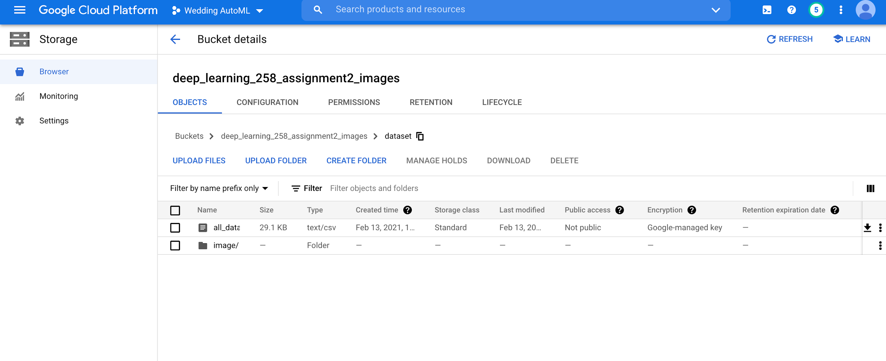
Hello Image Data
I have done Multilabel image classification for three labels: cake , flower and dress. This is the bucket having csv and all the images in the image/ folder.

Slide 2
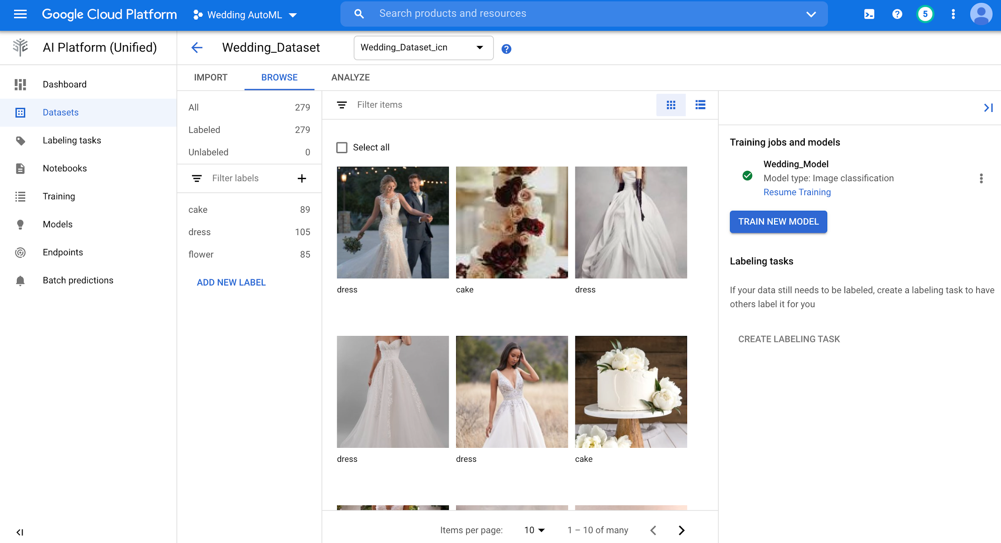
Hello Image Data
I have prepared the dataset by downloading images from google. Wedding_Dataset is created and data is imported into it. There are three labels: cake,dress and flower.

Slide 3
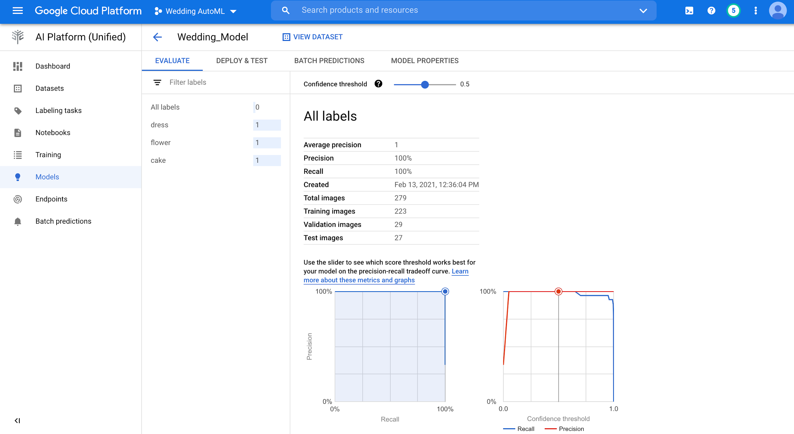
Hello Image Data
Model is created with 100% precision and recall.

Slide 4
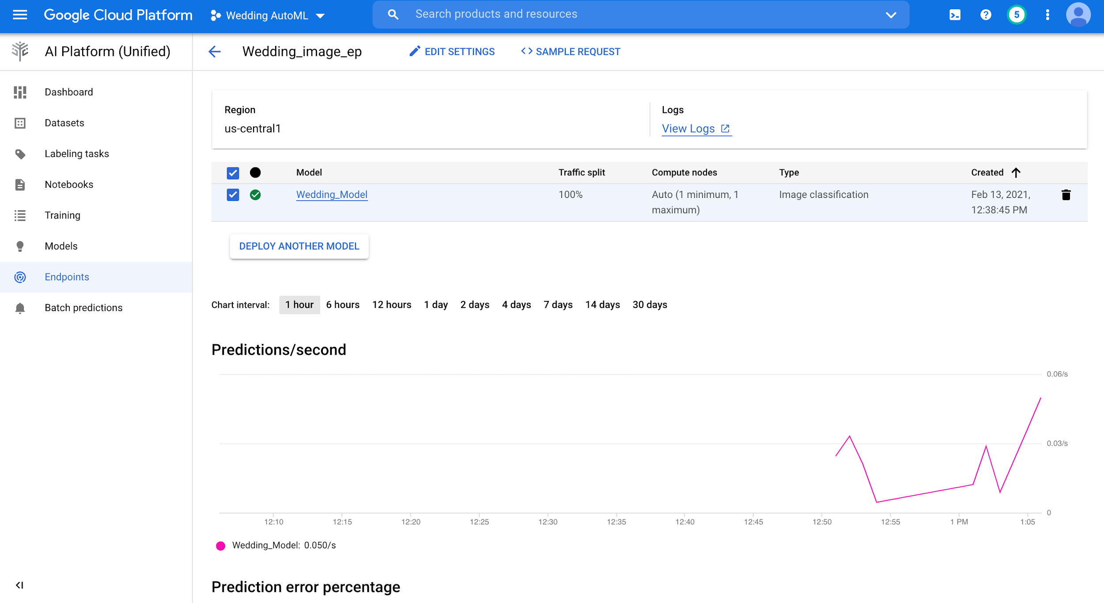
Hello Image Data
Endpoint is created.

Slide 5
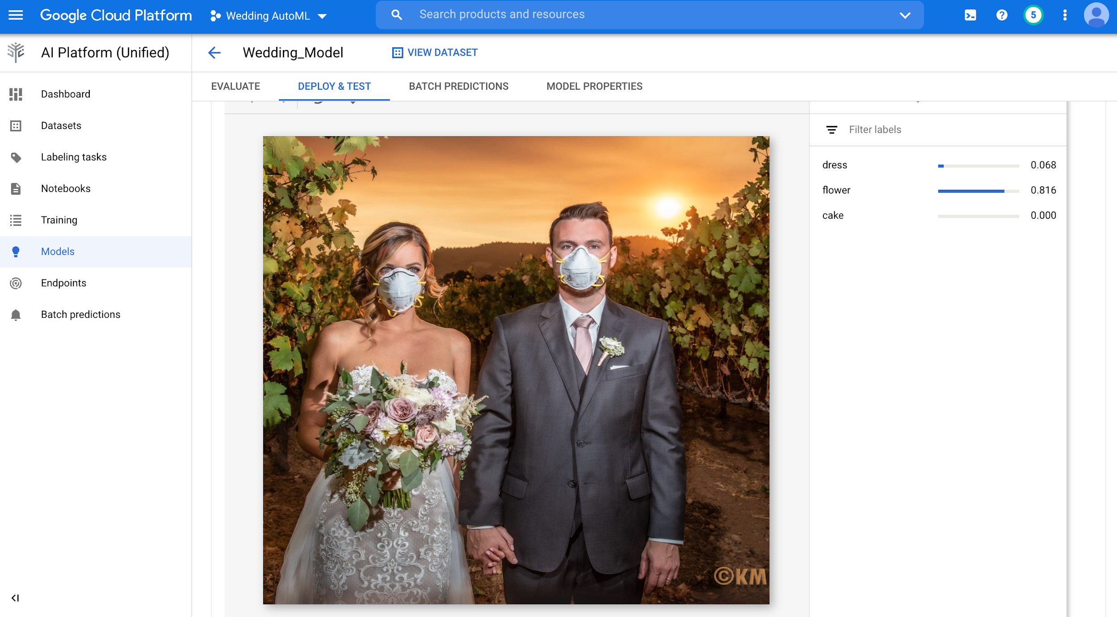
Hello Image Data
Prediction results

Slide 6
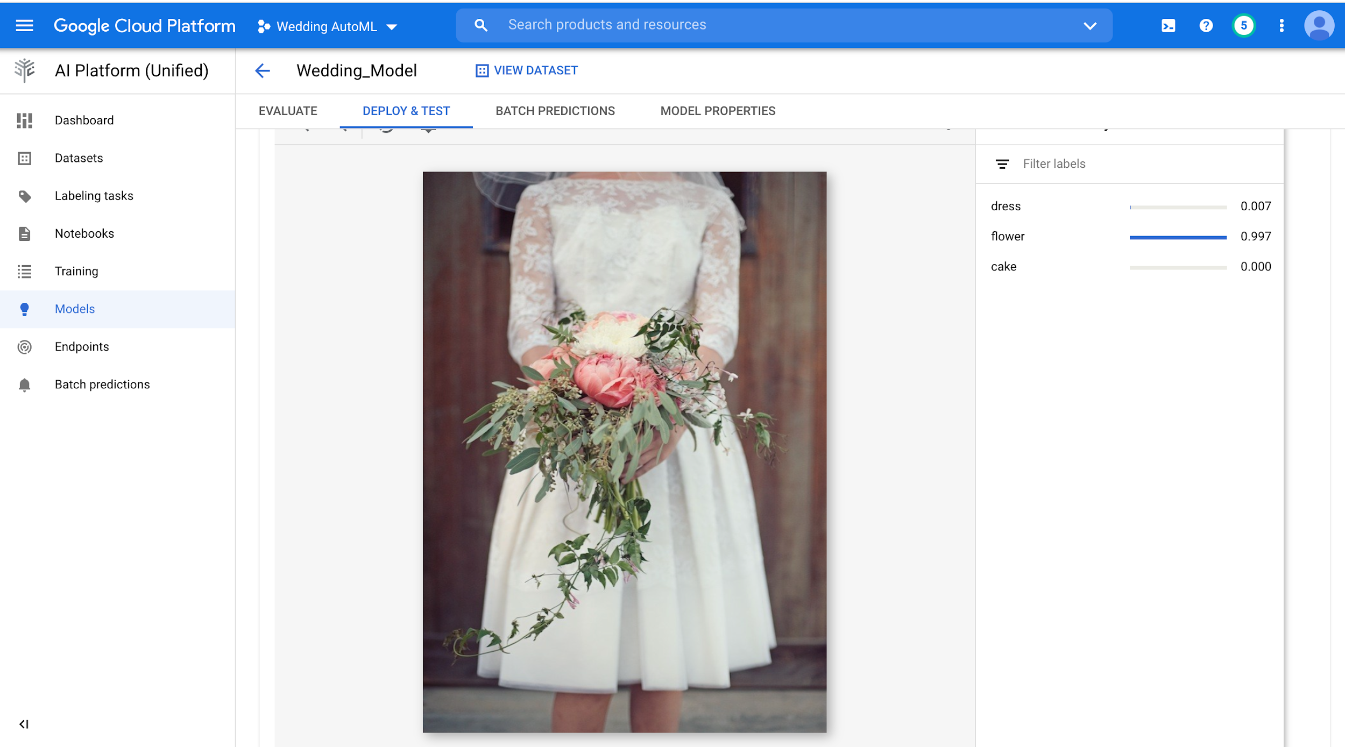
Hello Image Data
Prediction results

Slide 7
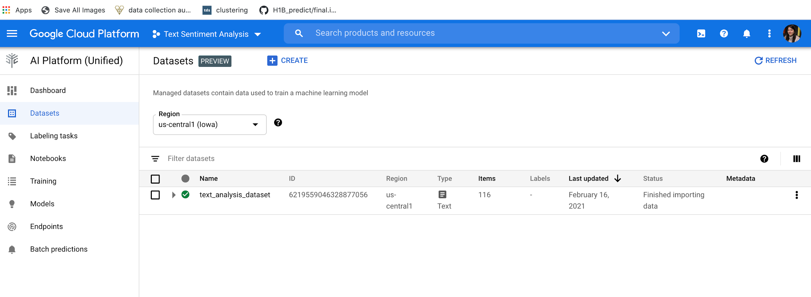
Hello text Data
I have created dataset for text sentiment analysis. Fetches text based on financial domain from google and inserted into the dataset with negative,neutral and positive as 0,1 and 2.

Slide 8
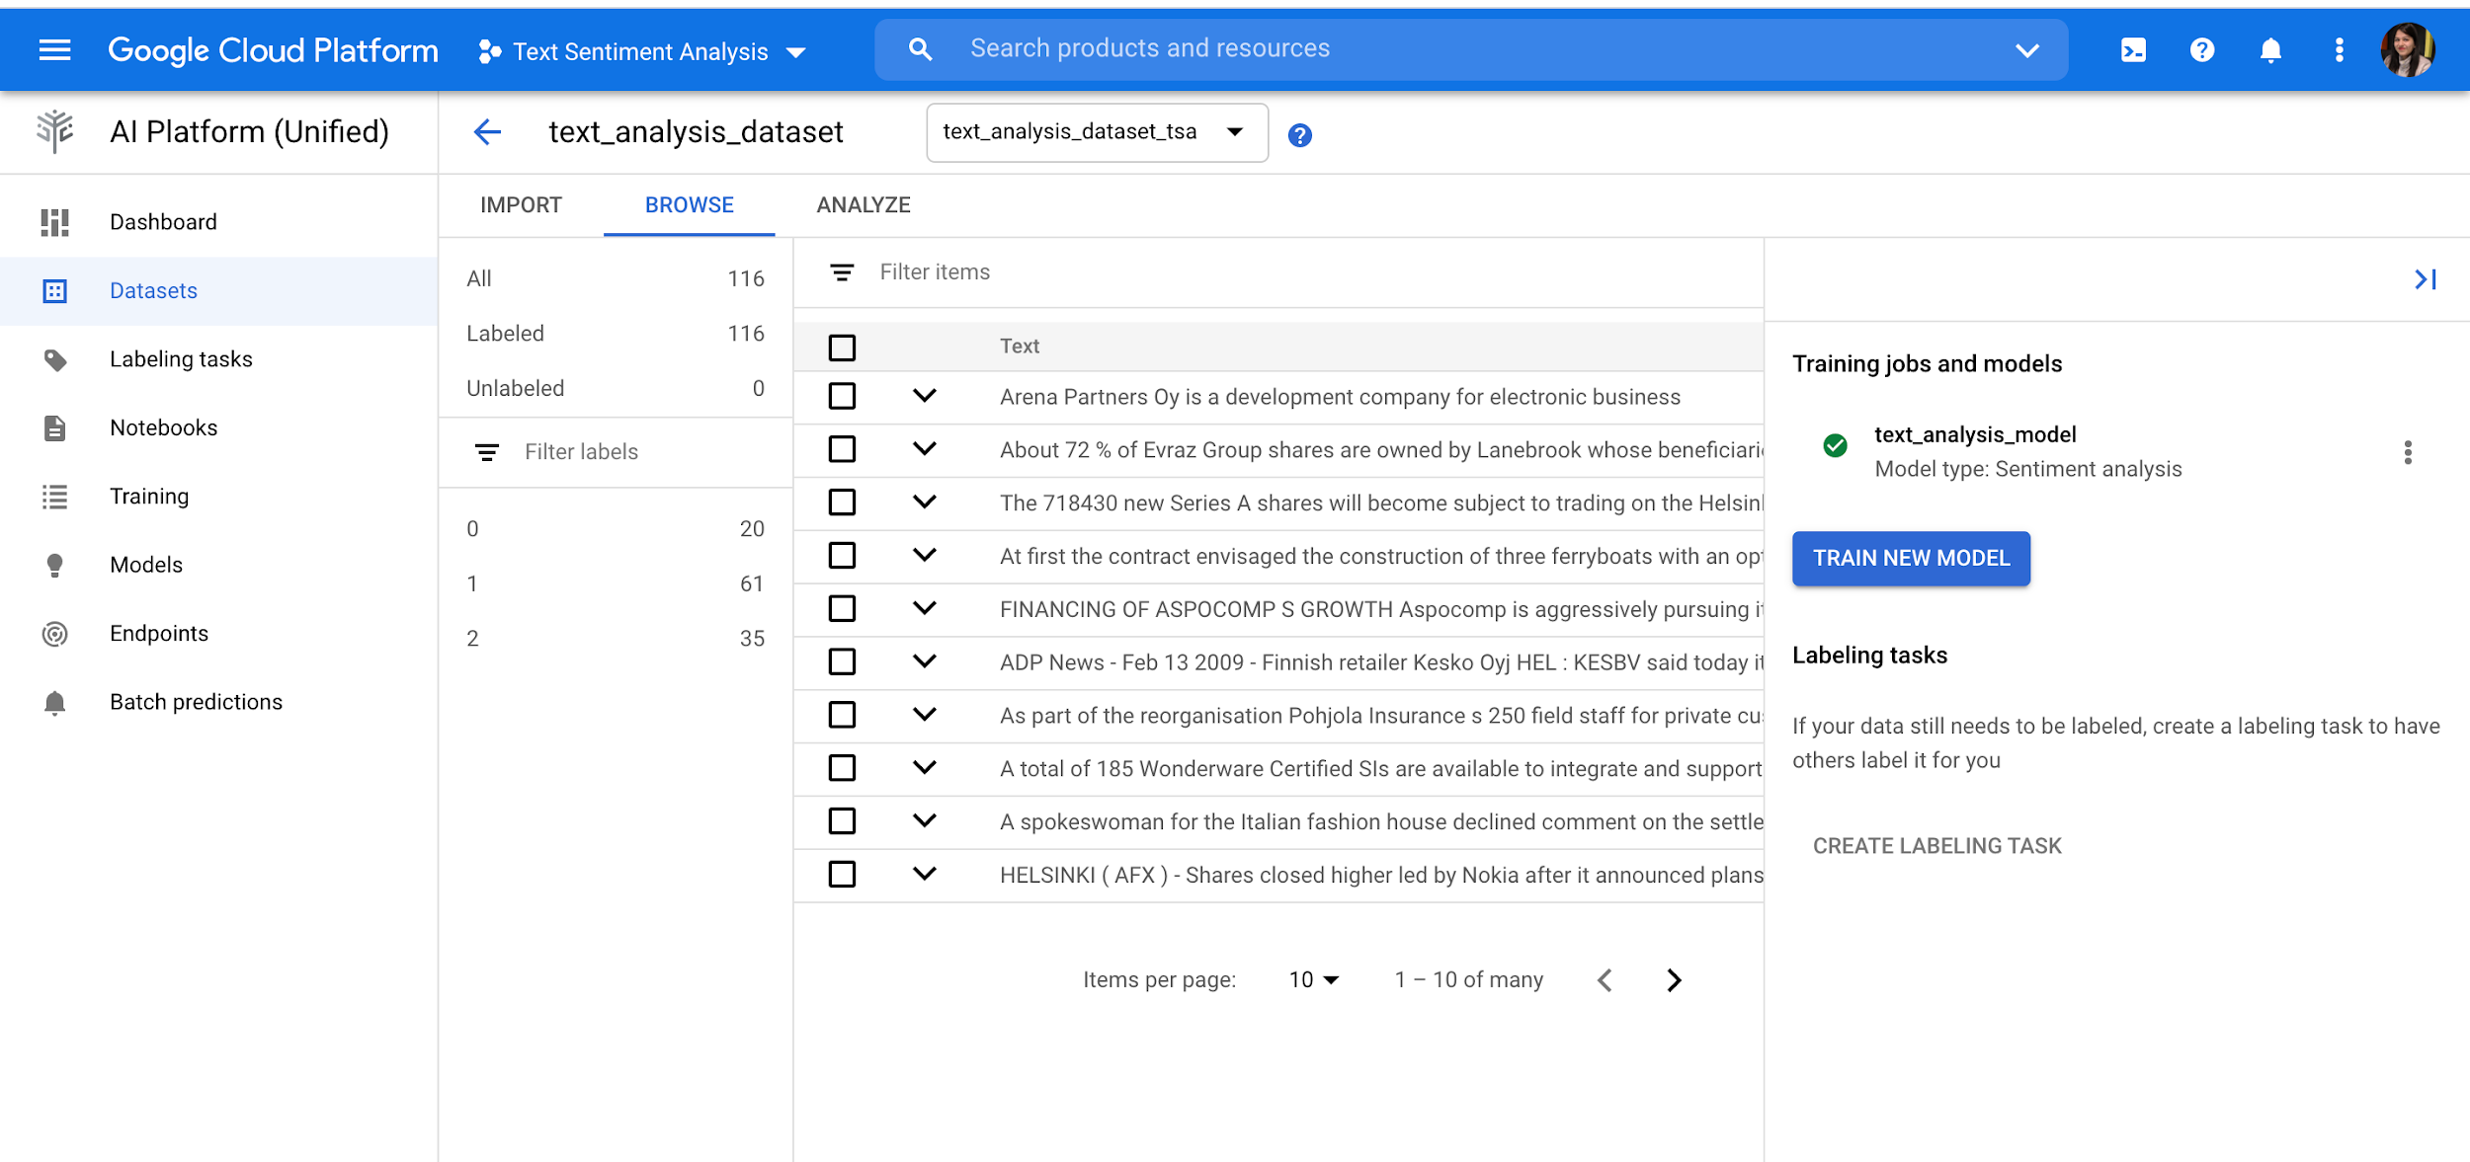
Hello text Data

Slide 9
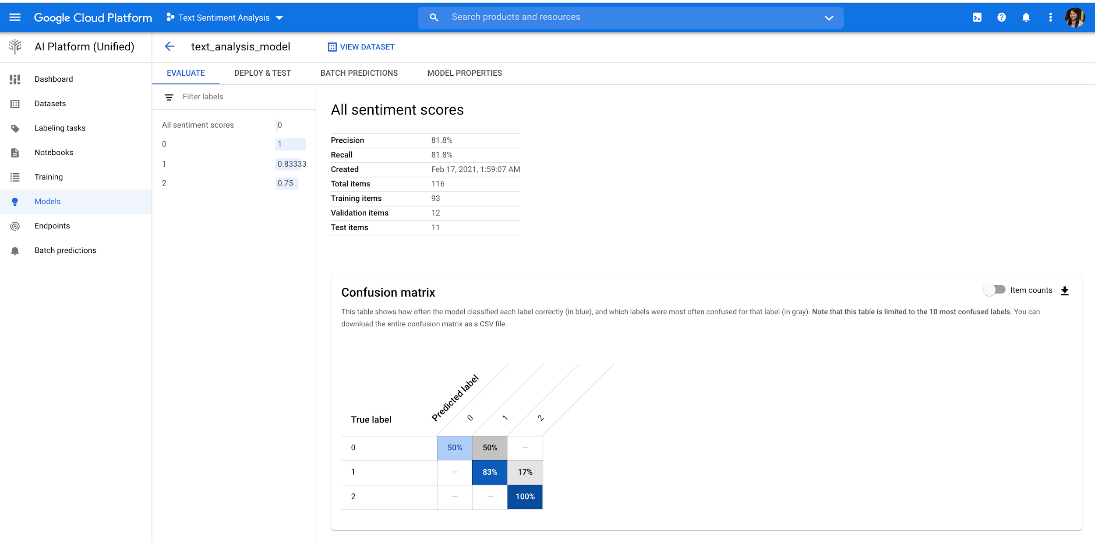
Hello text Data
Created text_analysis_model with 81.8% precision.

Slide 10
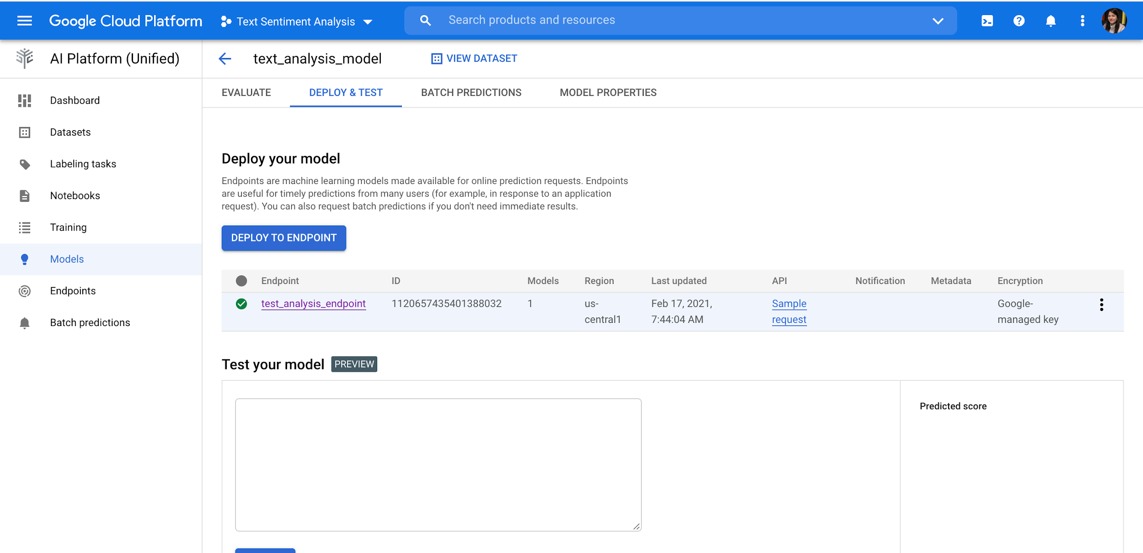
Hello text Data
Created text_analysis_endpoint

Slide 11
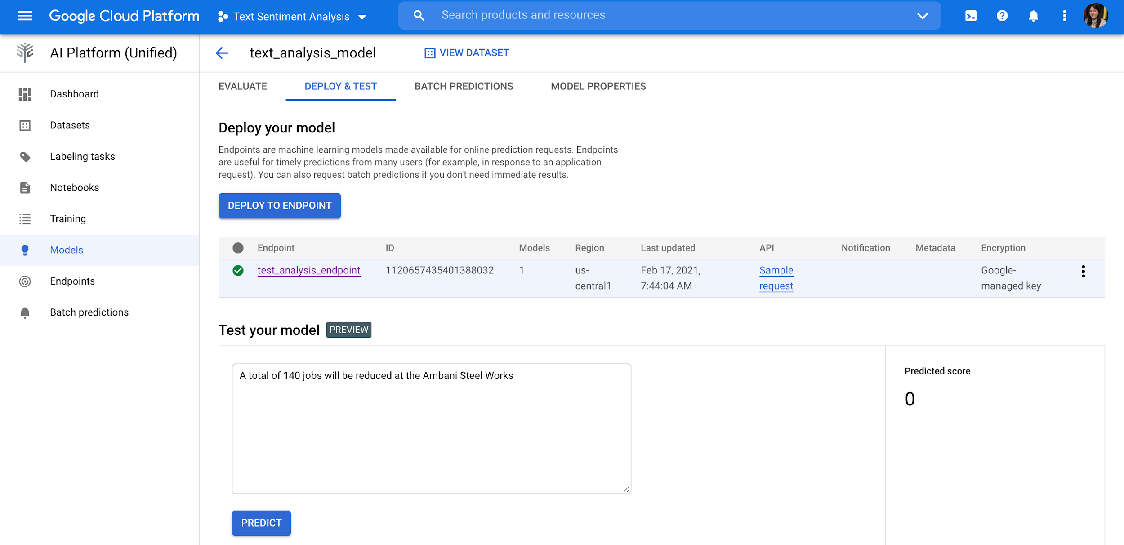
Hello text Data
Prediction result : Negative : 0

Slide 12
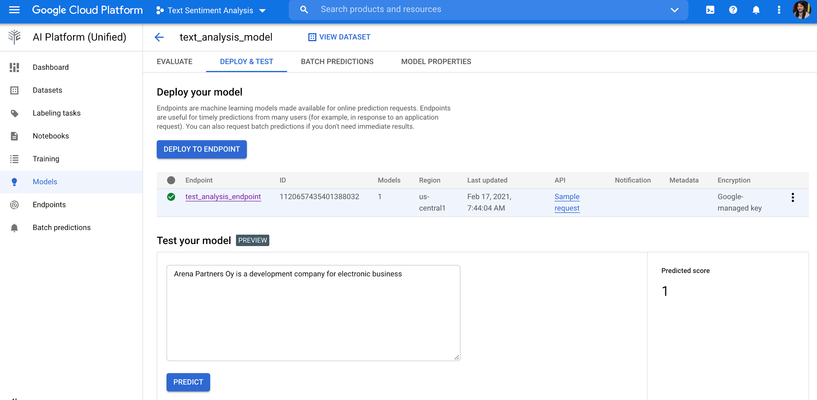
Hello text Data
Prediction: Neutral : 1

Slide 13
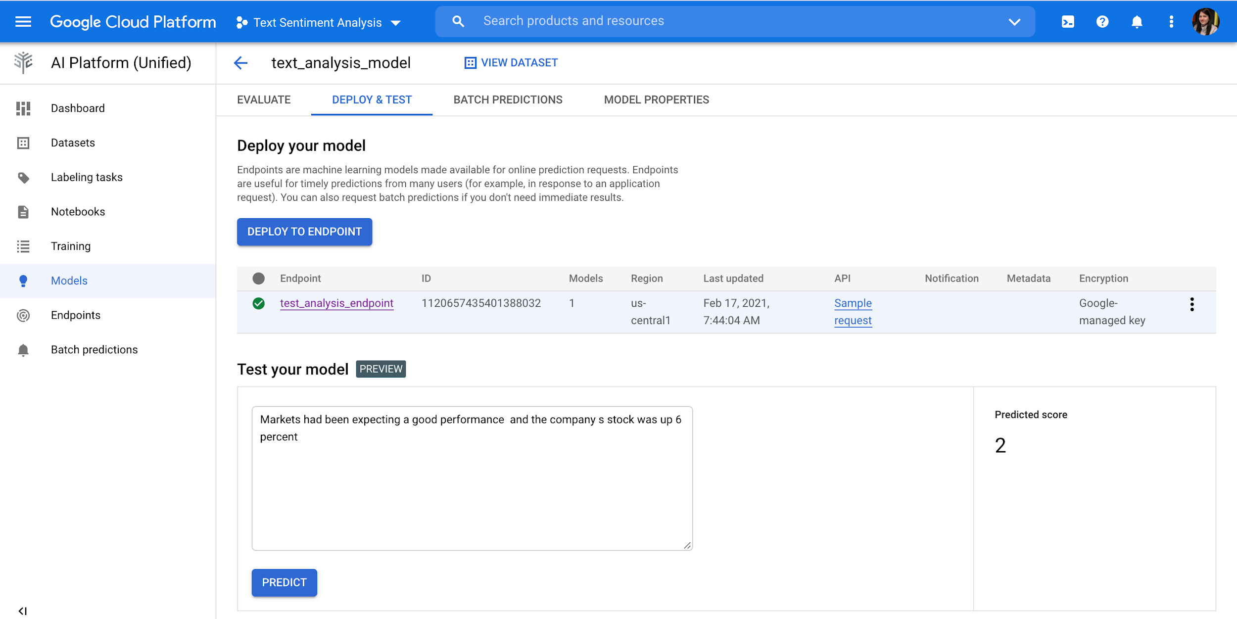
Hello text Data
Prediction : Positive : 2

Slide 14
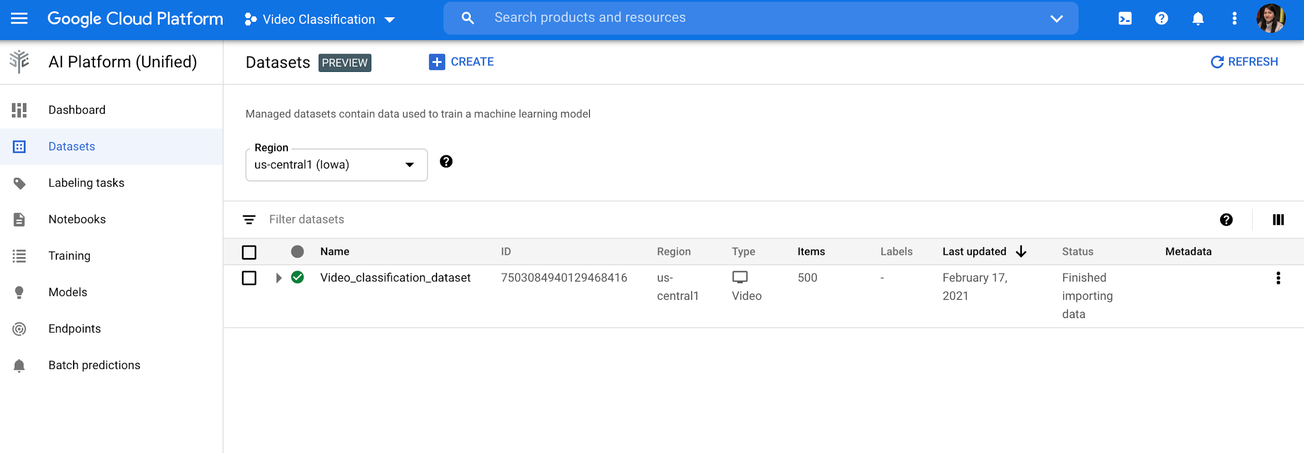
Hello video Data
I am performing Video classification , created Video_classification_dataset

Slide 15
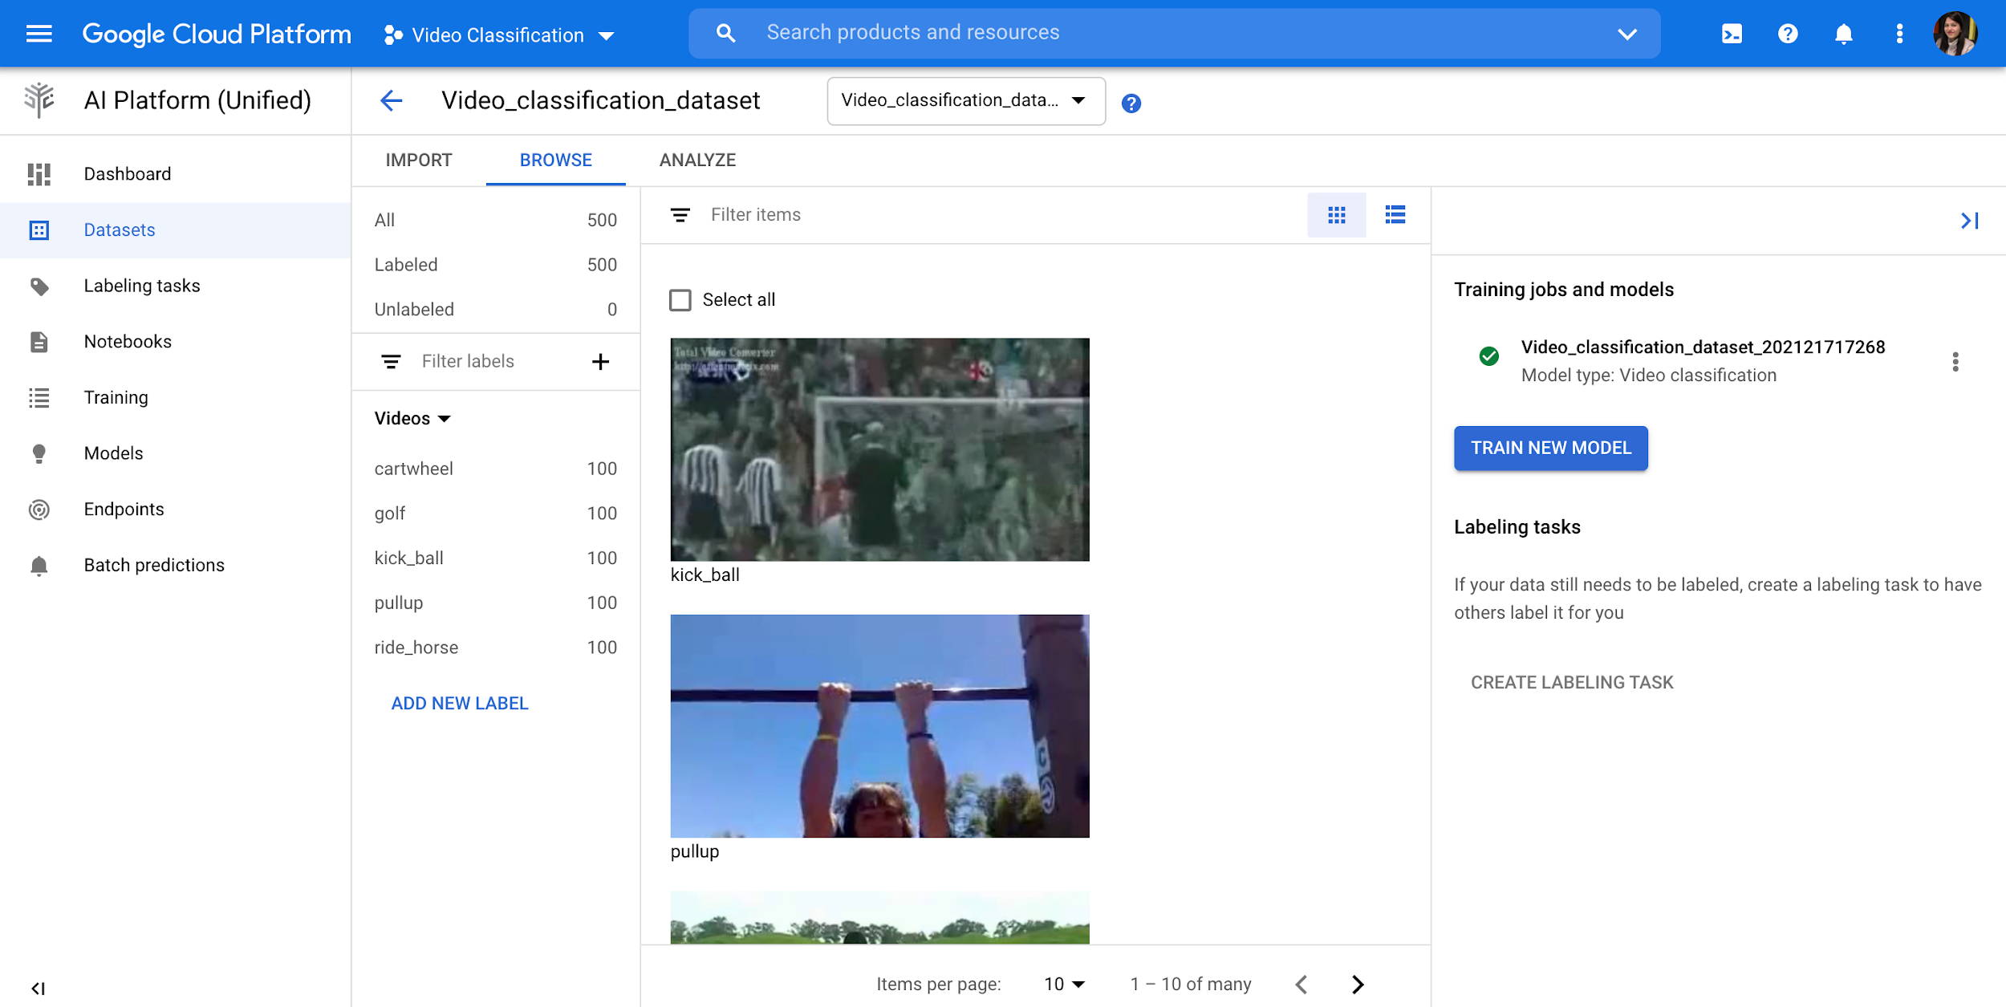
Hello video Data
Dataset having 5 labels: cartwheel , golf, kick_ball, pullup, and ride_horse.

Slide 16
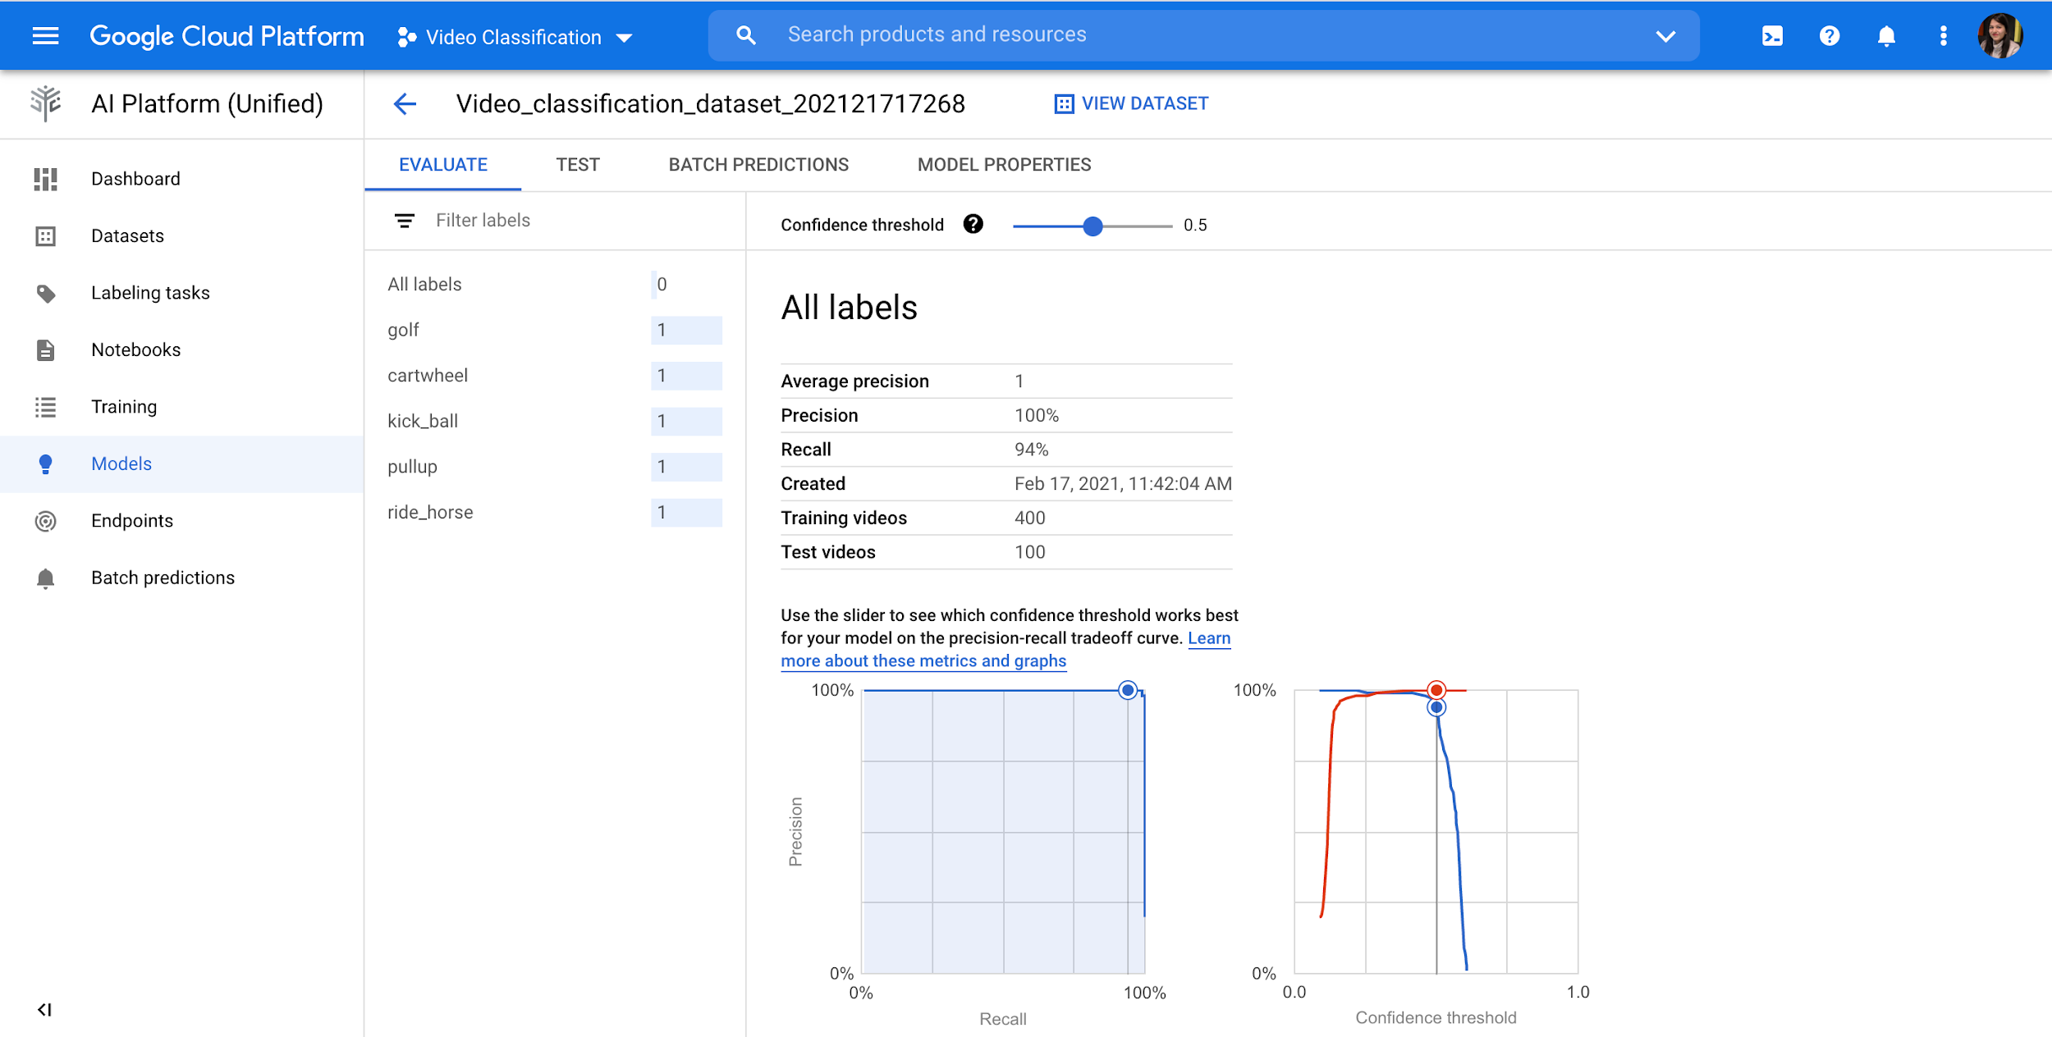
Hello video Data
Created model with 100% precision.

Slide 17
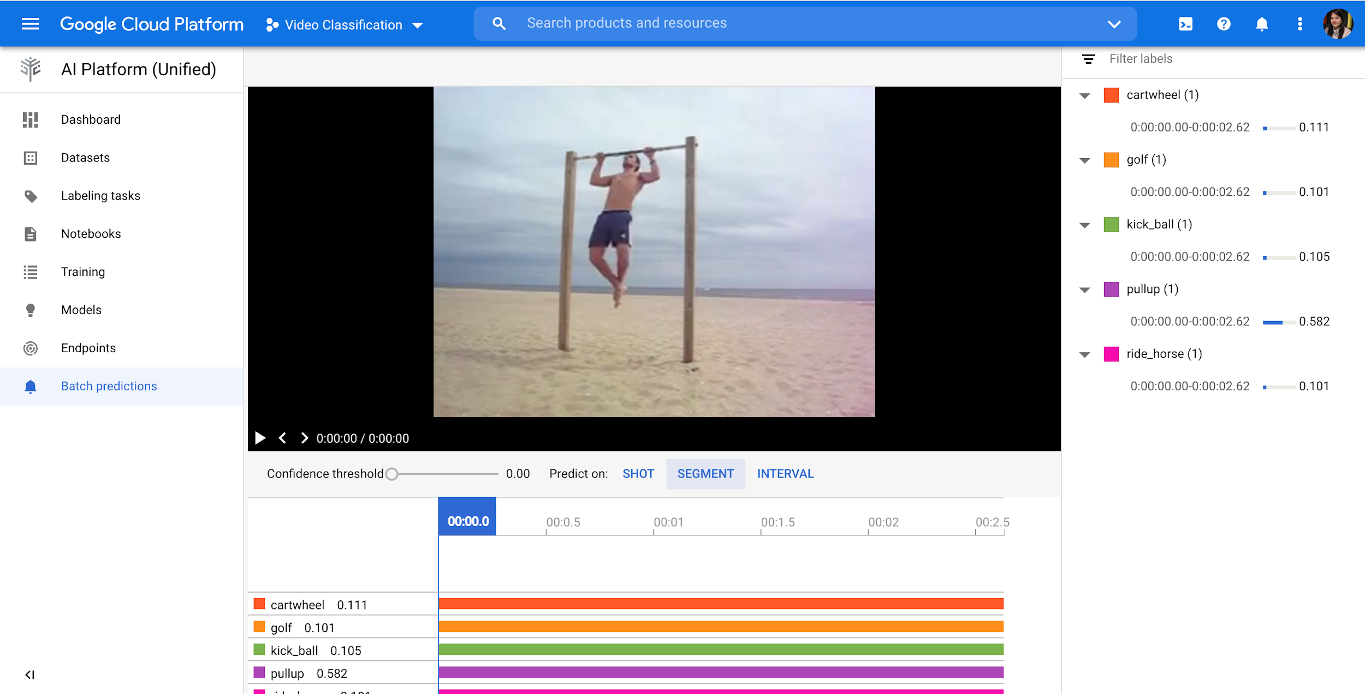
Hello video Data
Prediction results: pullup with 0.58%

Slide 18
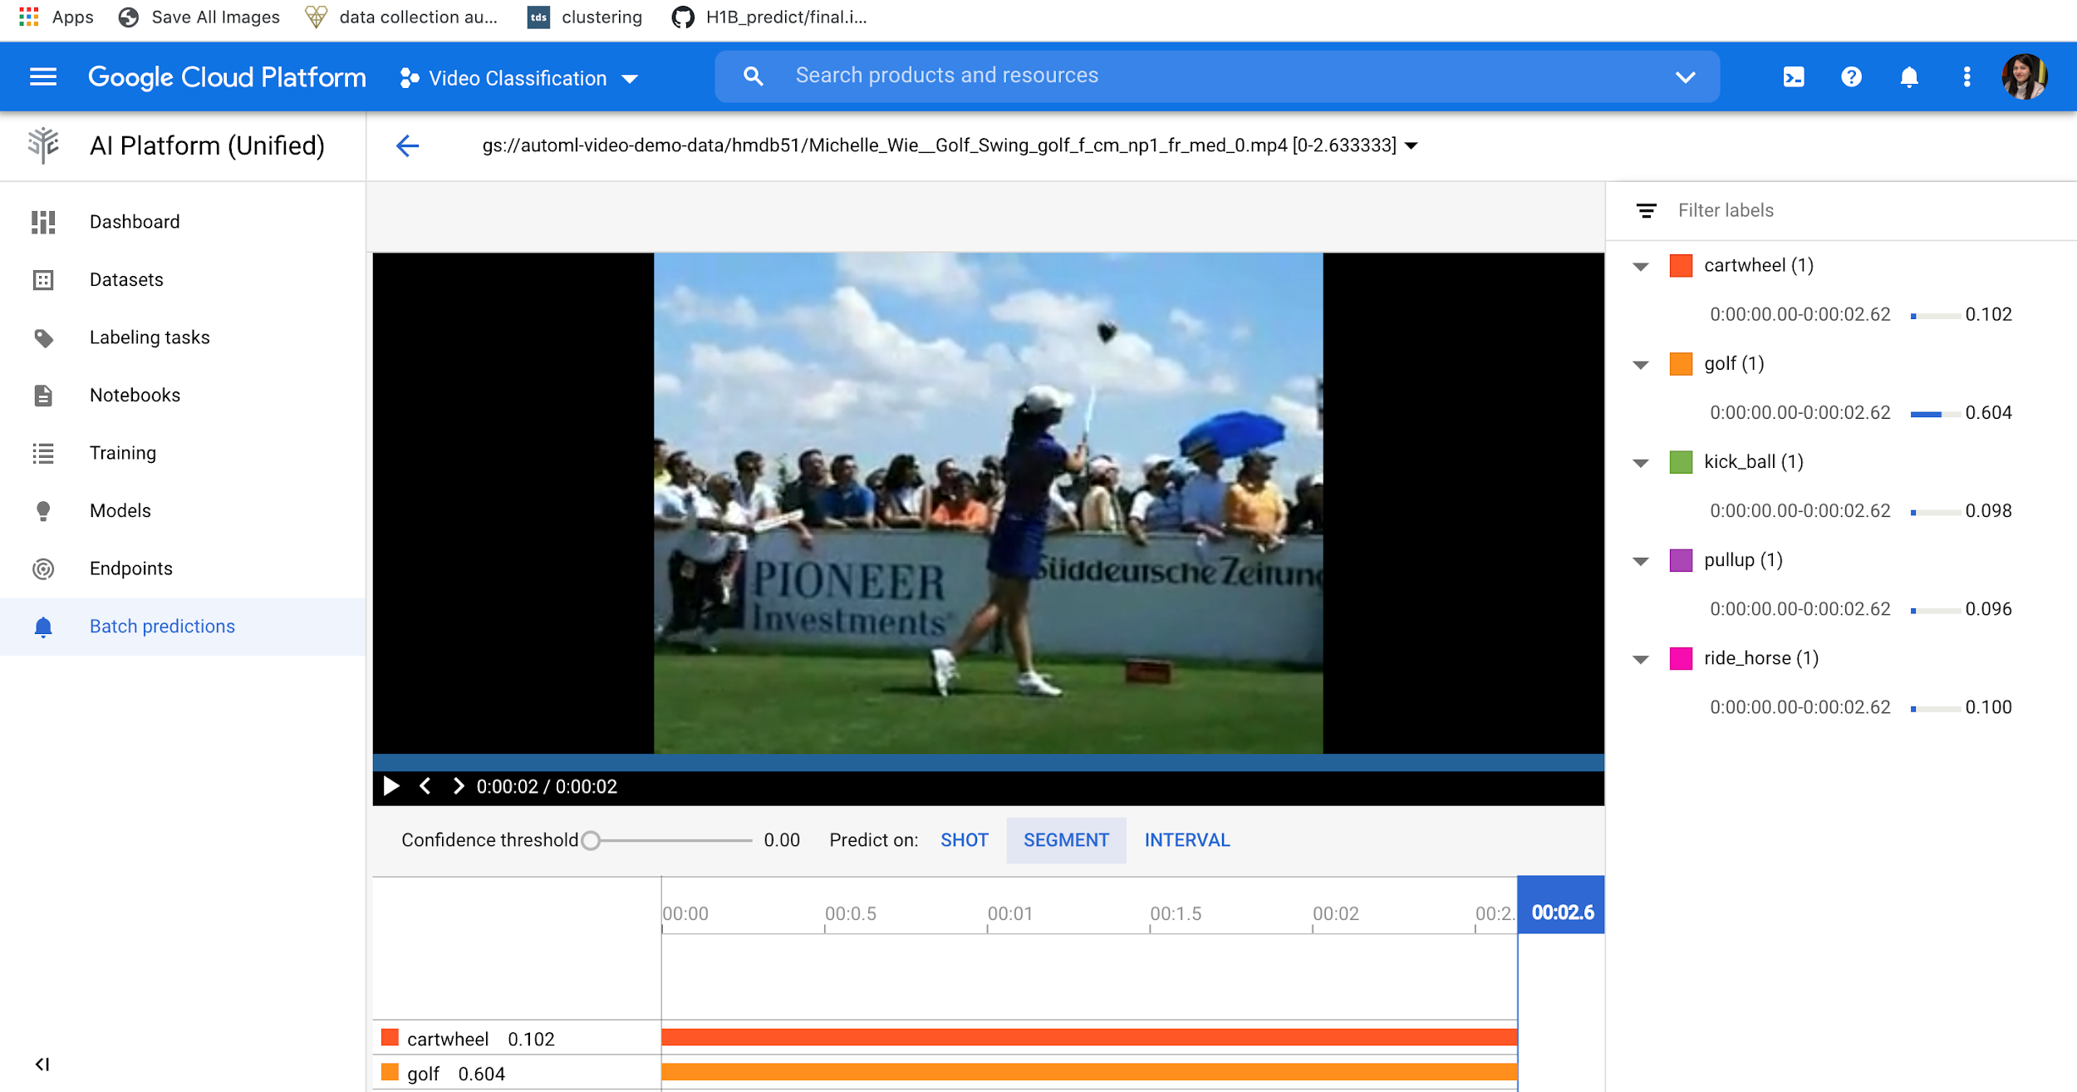
Hello video Data
Prediction result golf with 0.60%

Slide 19
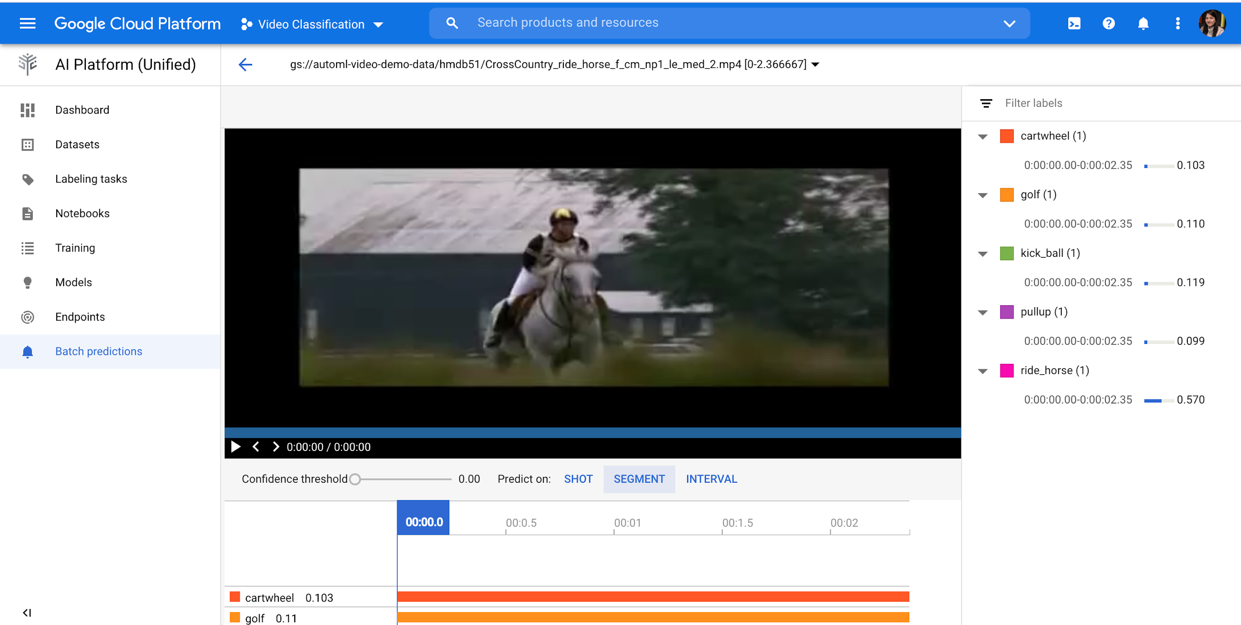
Hello video Data
Prediction result ride_horse with 0.57%

Slide 20
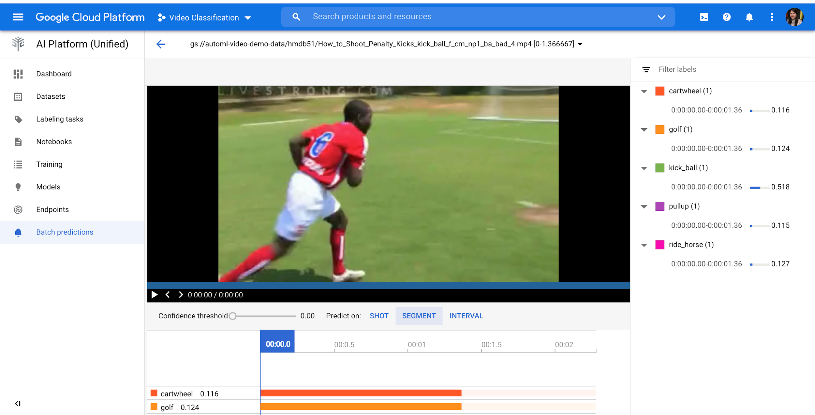
Hello video Data
Prediction result kick_ball with 0.51%

Slide 21
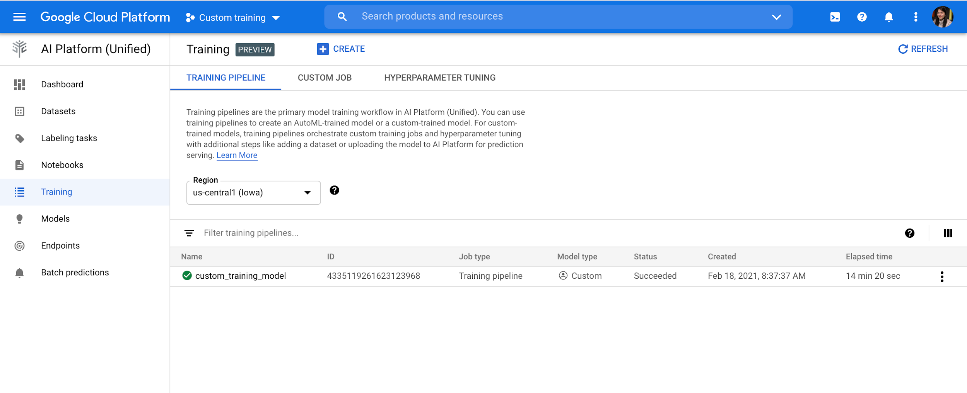
Hello custom training
Created custom_training_model

Slide 22
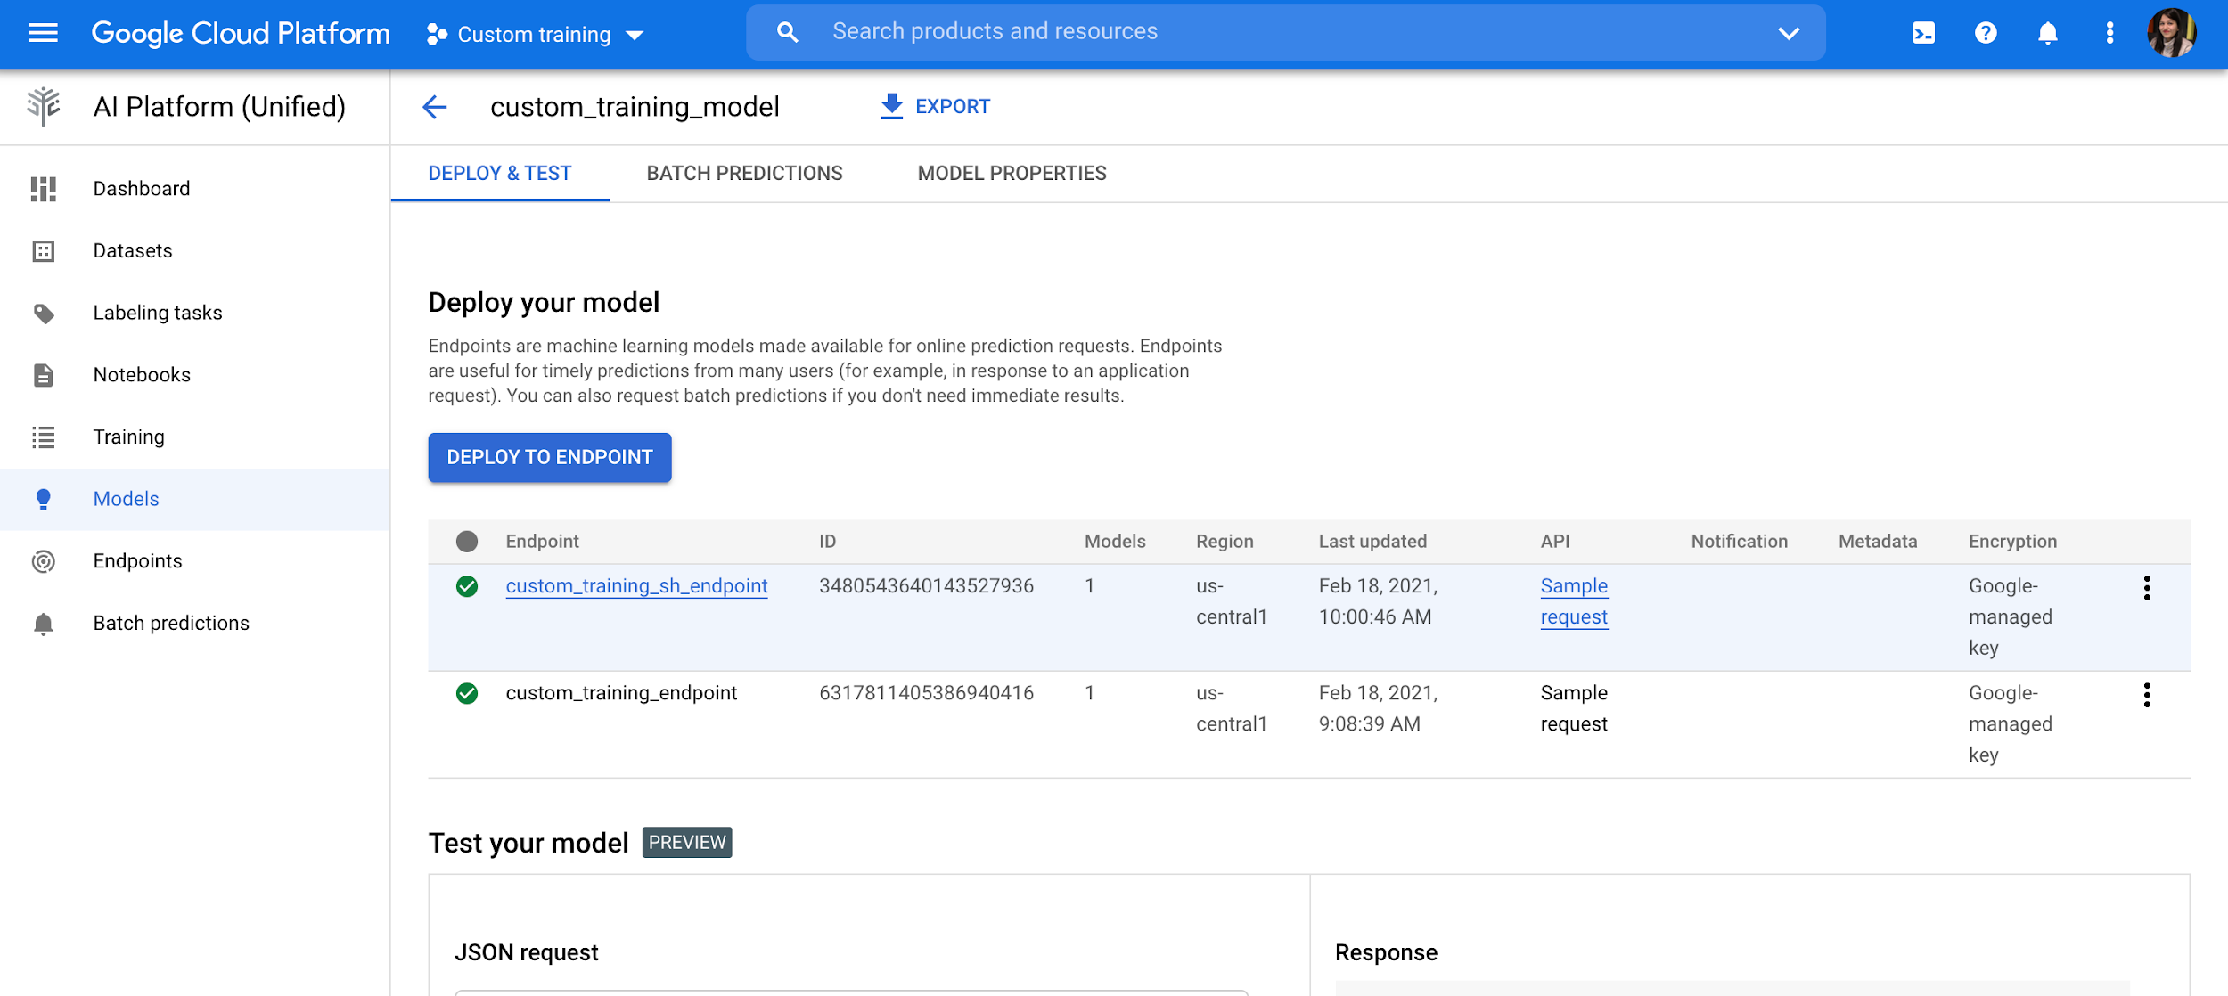
Hello custom training
Created custom_training_sh_endpoint

Slide 23
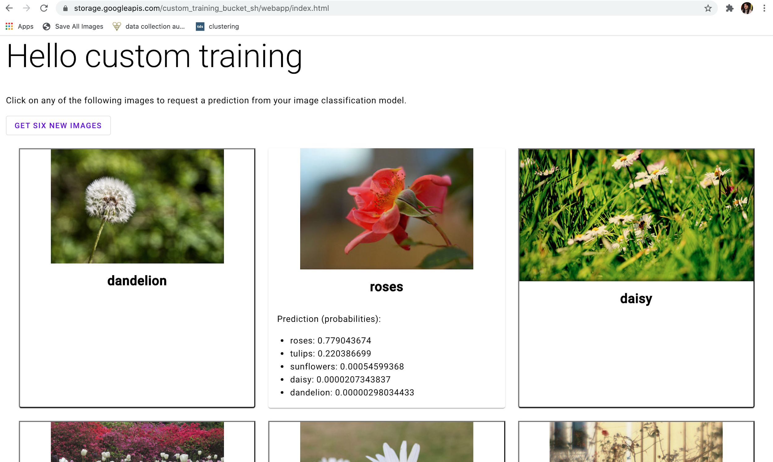
Hello custom training
Prediction results of different images

Slide 24
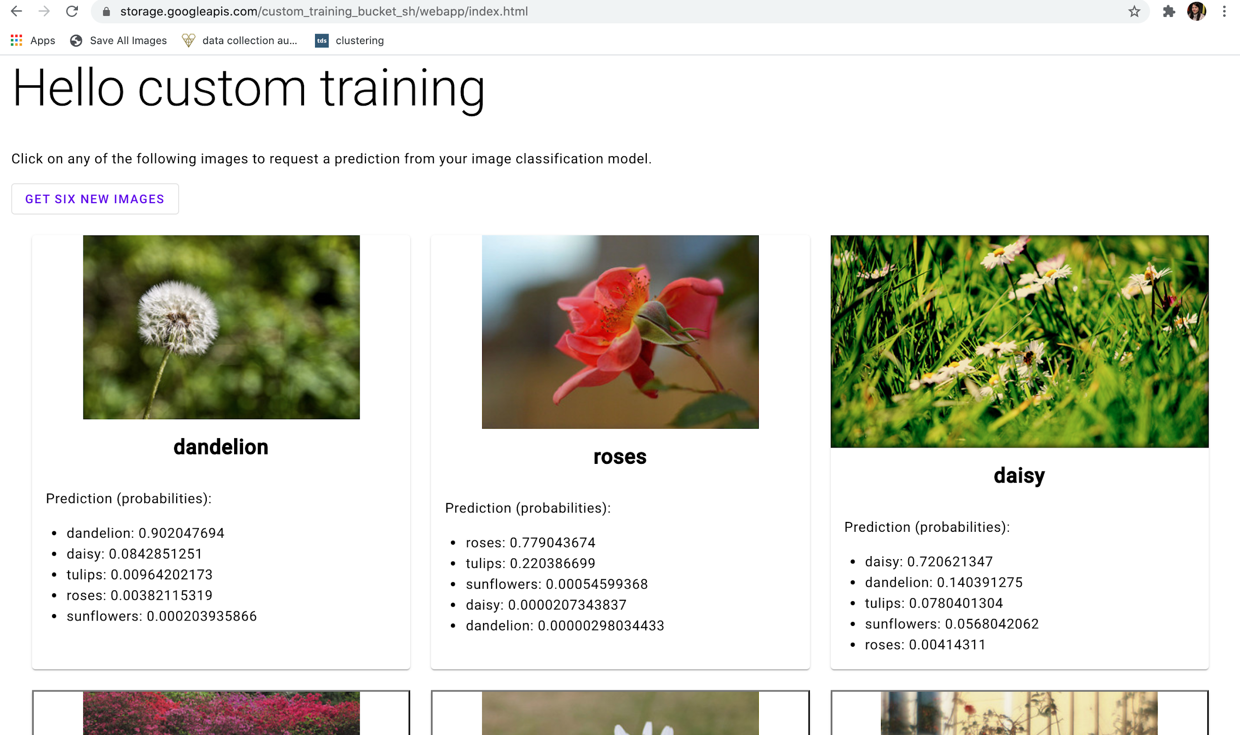
Hello custom training
Prediction results of different images

Slide 25
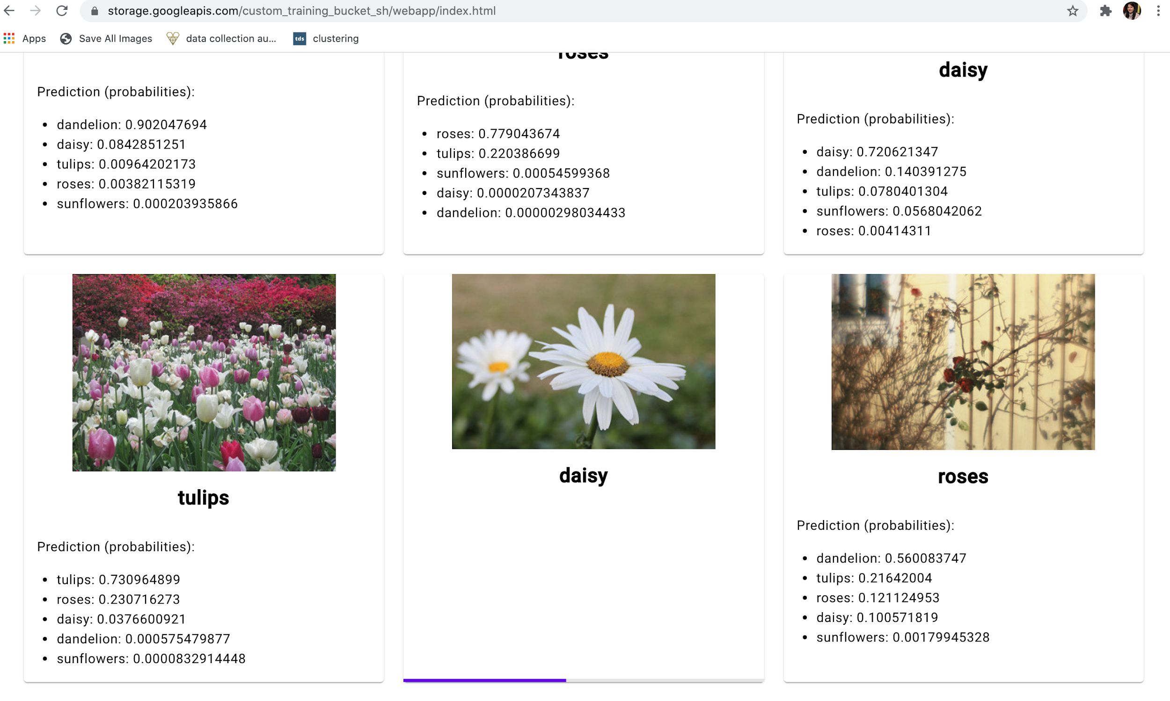
Hello custom training
Prediction results of different images

Slide 26
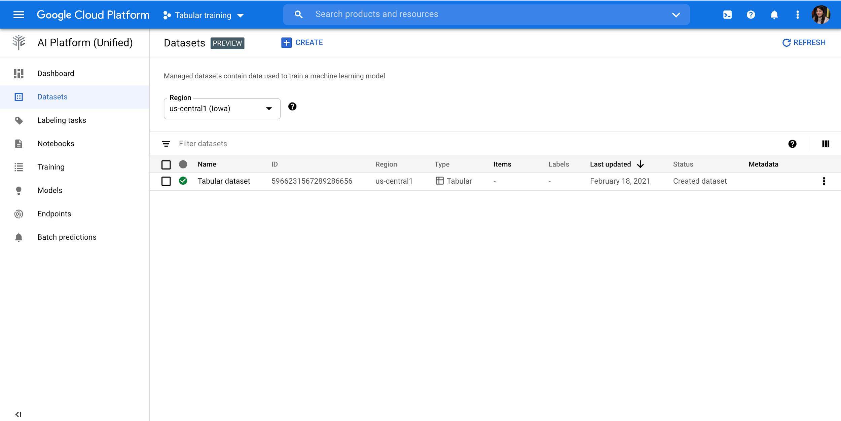
Hello tabular data
Created Tabular_dataset

Slide 27
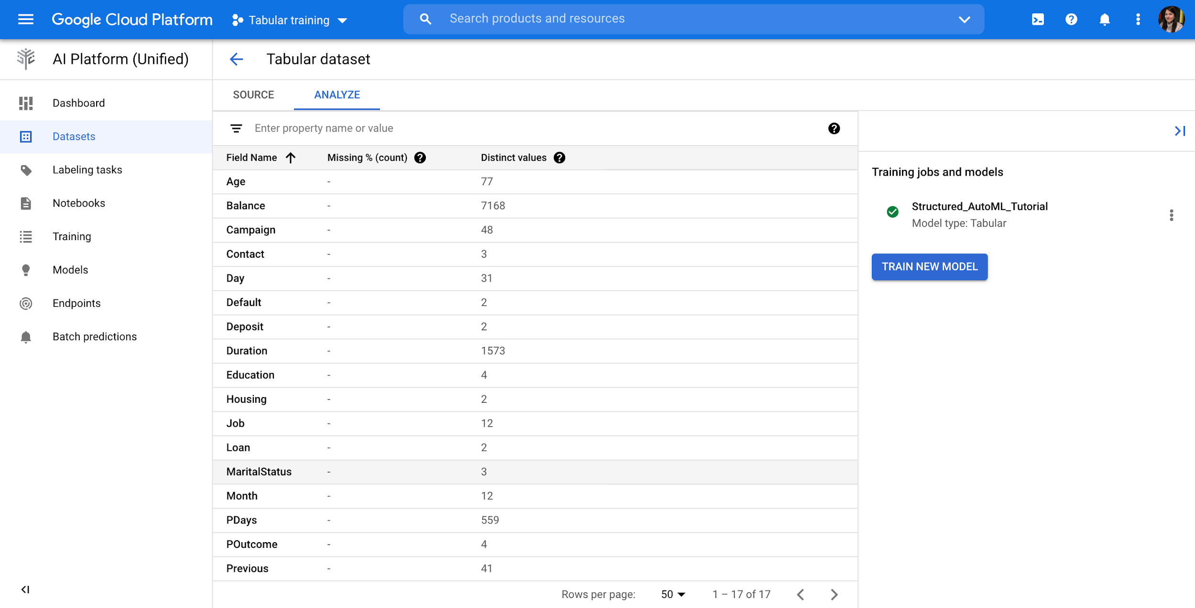
Hello tabular data
Dataset with following field names

Slide 28
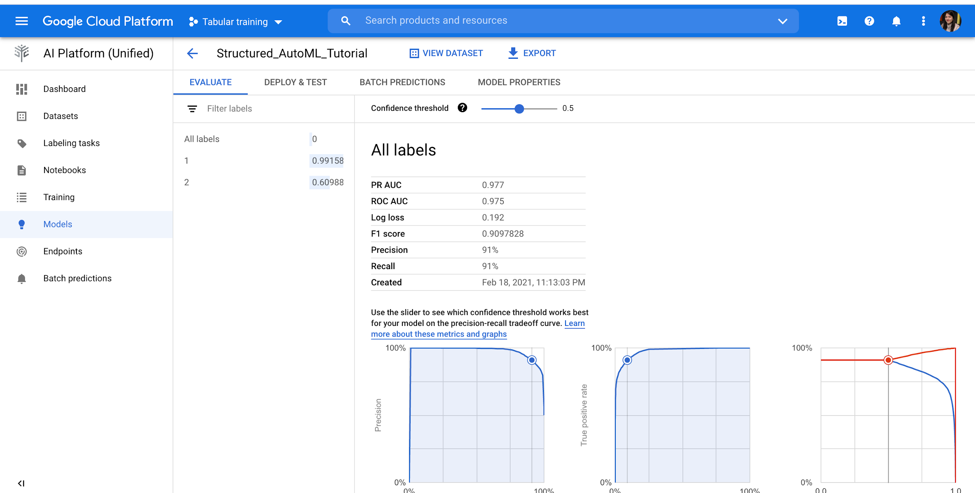
Hello tabular data
Deployed model with ROC AUC as 97.5%

Slide 29
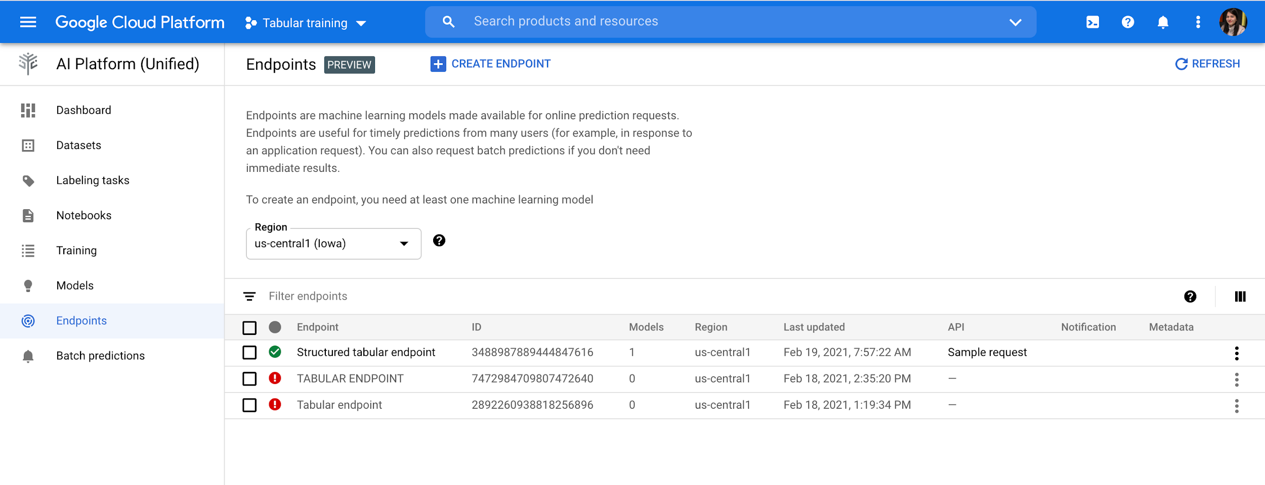
Hello tabular data
Deployed Structured tabular endpoint

Slide 30
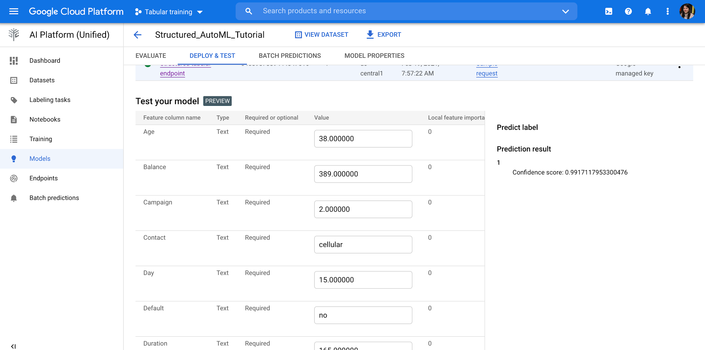
Hello tabular data
Prediction result: 1 with 99% confidence

Slide 31
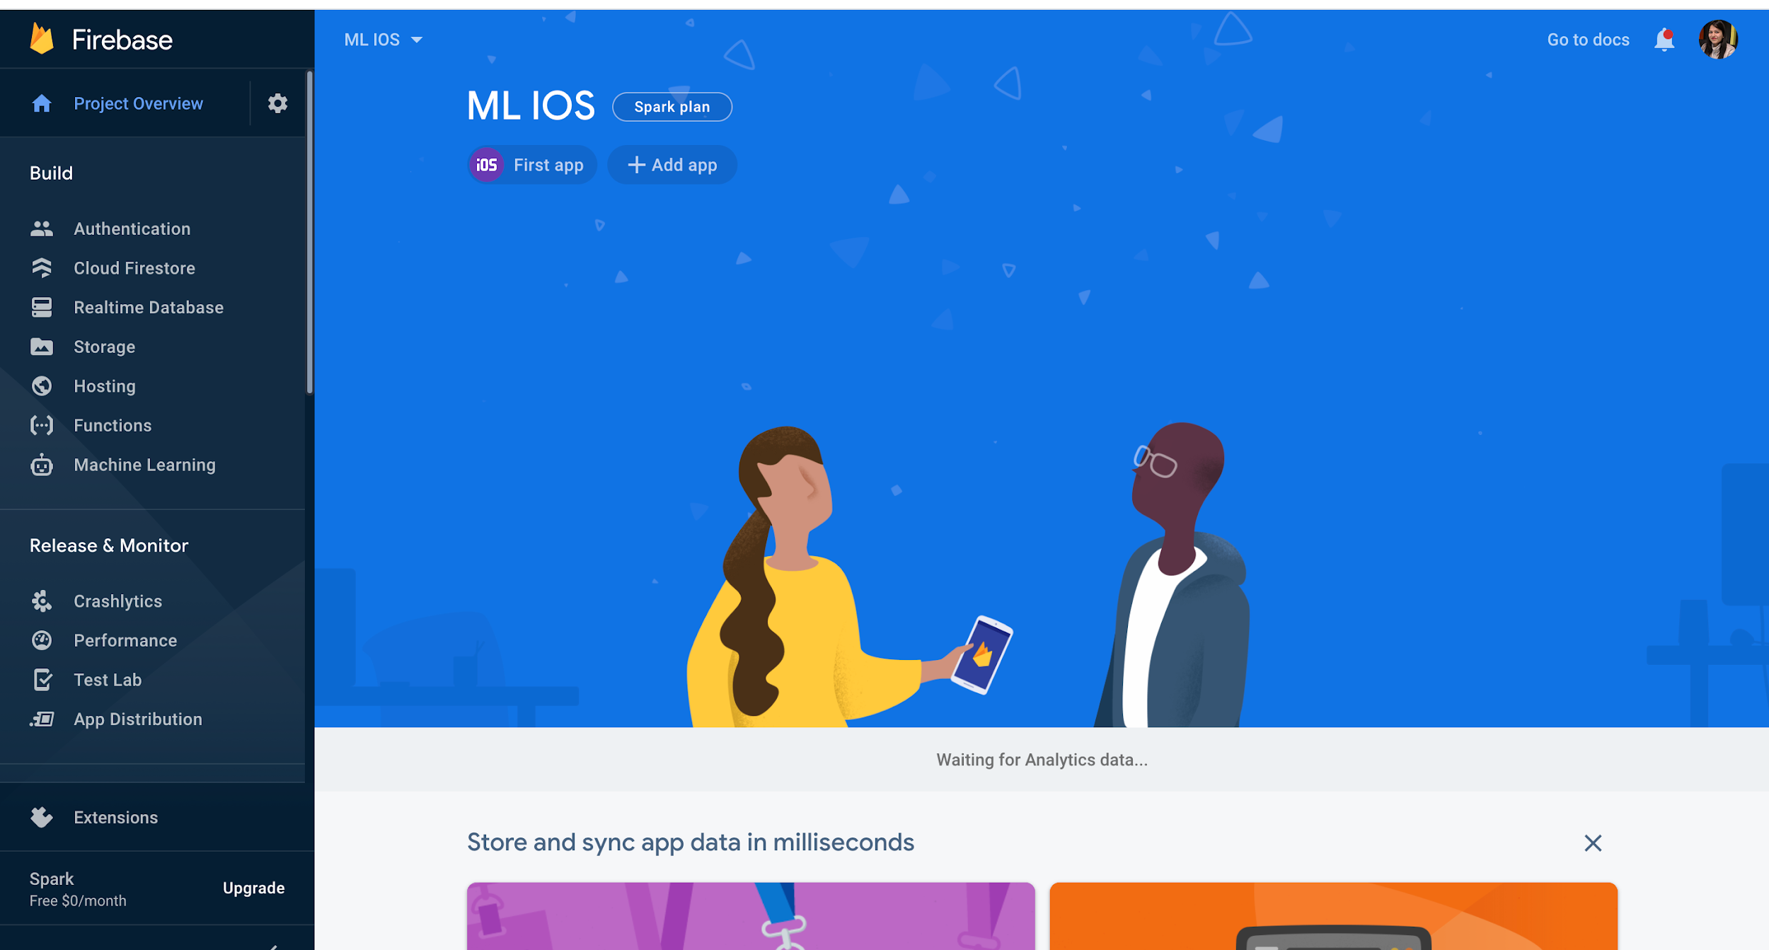
Deployment of Vision Model to Mobile Device
Created project in Firebase console and added an iOS sample app.

Slide 32
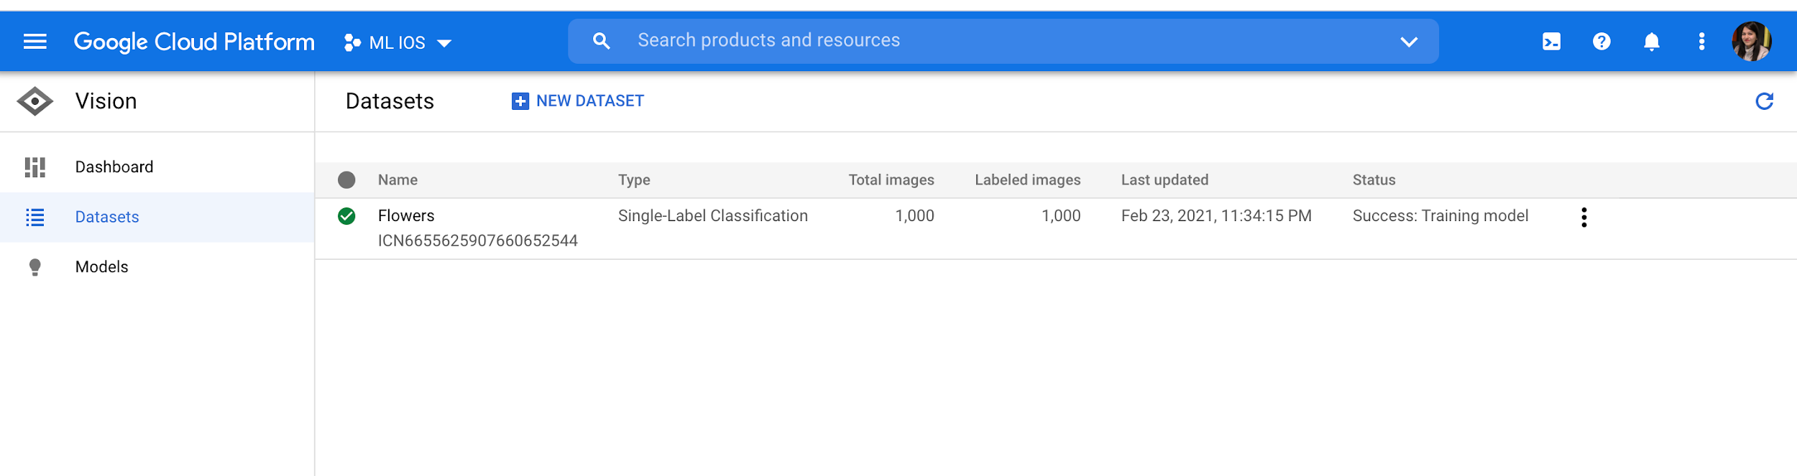
Deployment of Vision Model to Mobile Device
Created Flowers dataset in Vision and uploaded Flowers.zip.

Slide 33
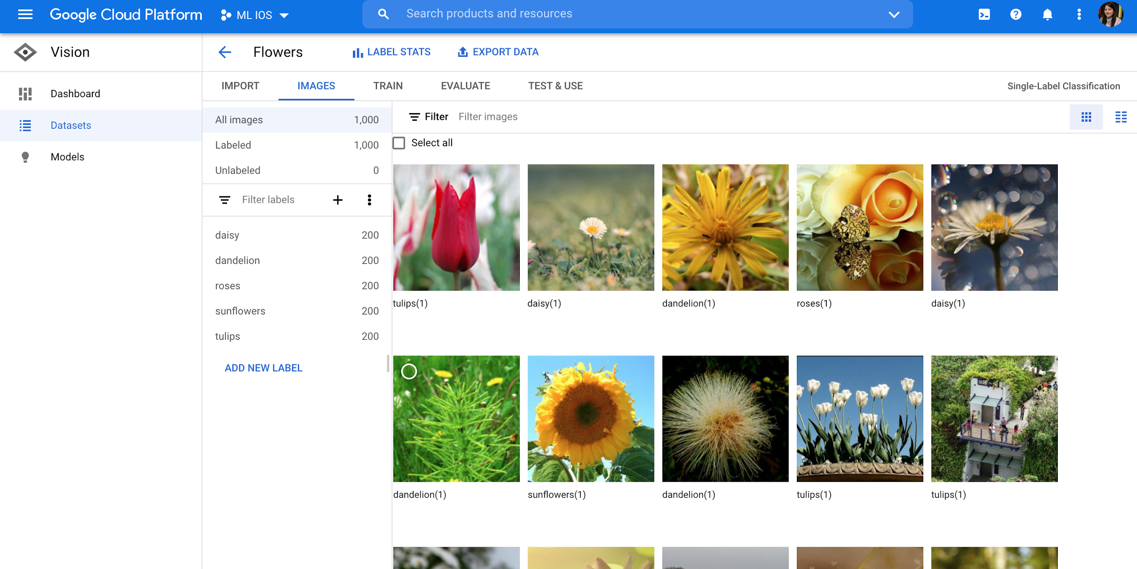
Deployment of Vision Model to Mobile Device
Flowers dataset

Slide 34
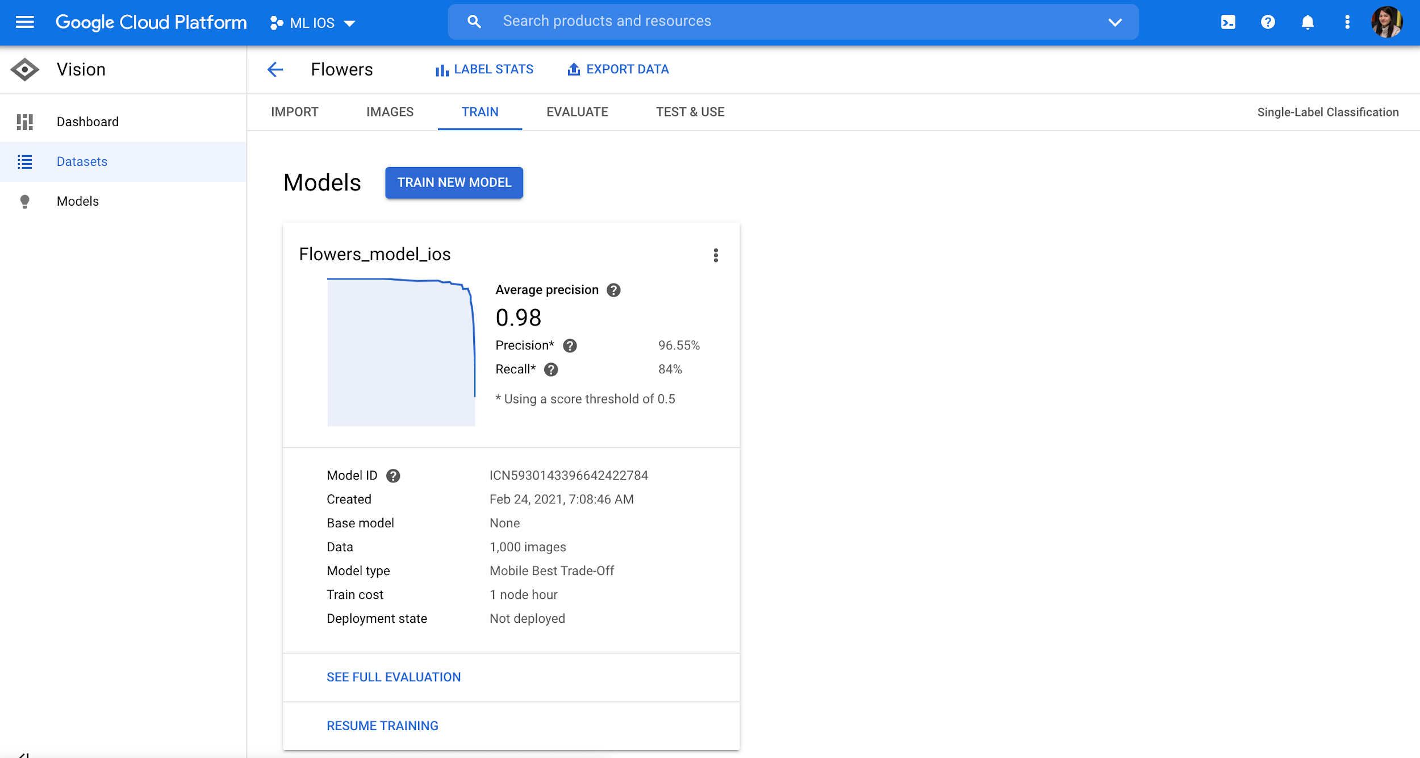
Deployment of Vision Model to Mobile Device
Trained model in Vision and exported model in TFLite format to export into the mobile device.

Slide 35
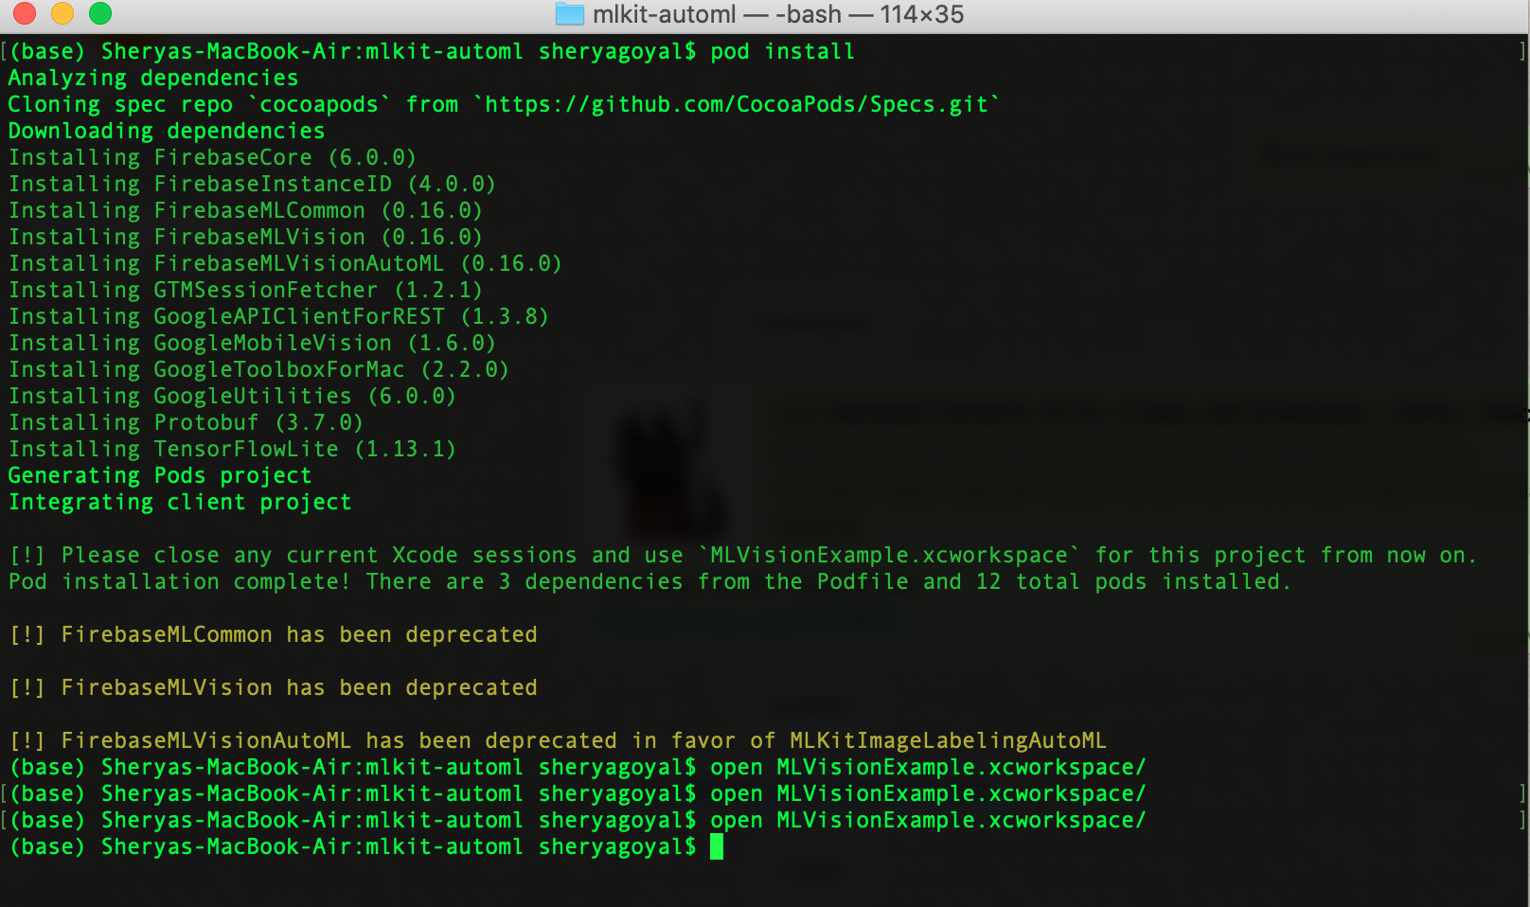
Deployment of Vision Model to Mobile Device
Installed pod into the system and then loaded code into the Xcode and replaced the model that created in th vision.

Slide 36
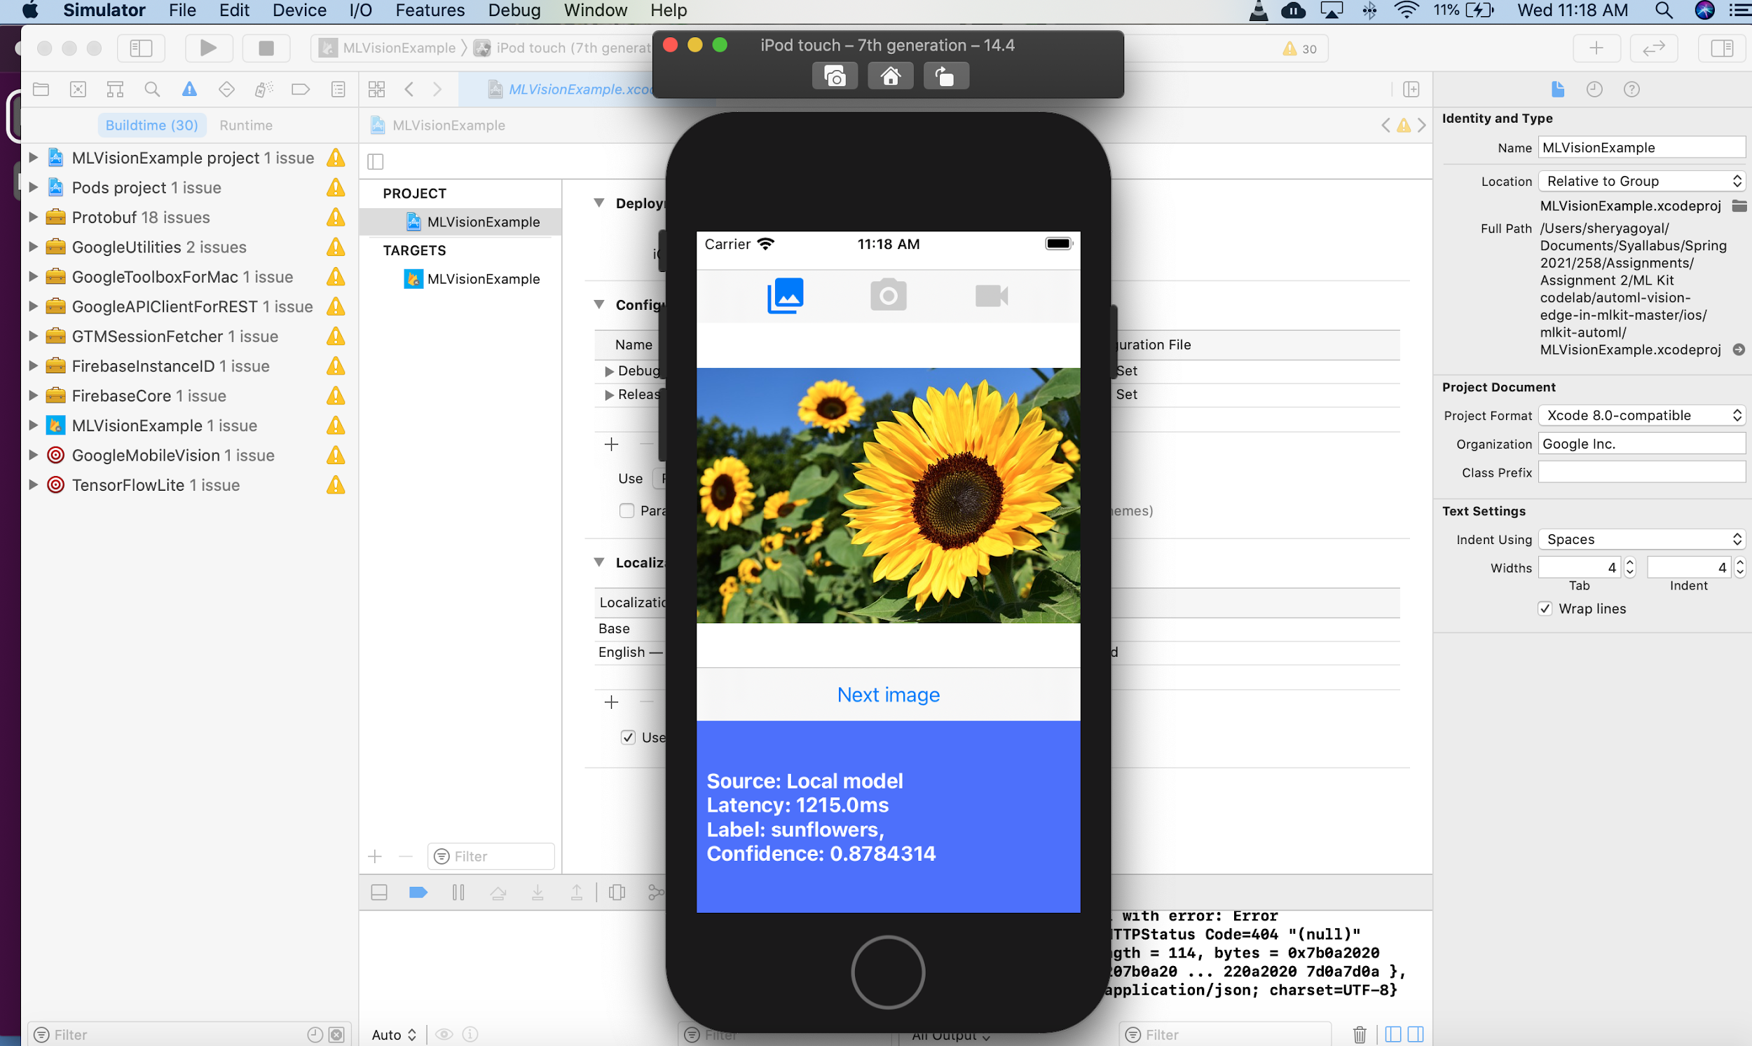
Deployment of Vision Model to Mobile Device
Prediction results: Ran the model in the ios Simulator

Slide 37
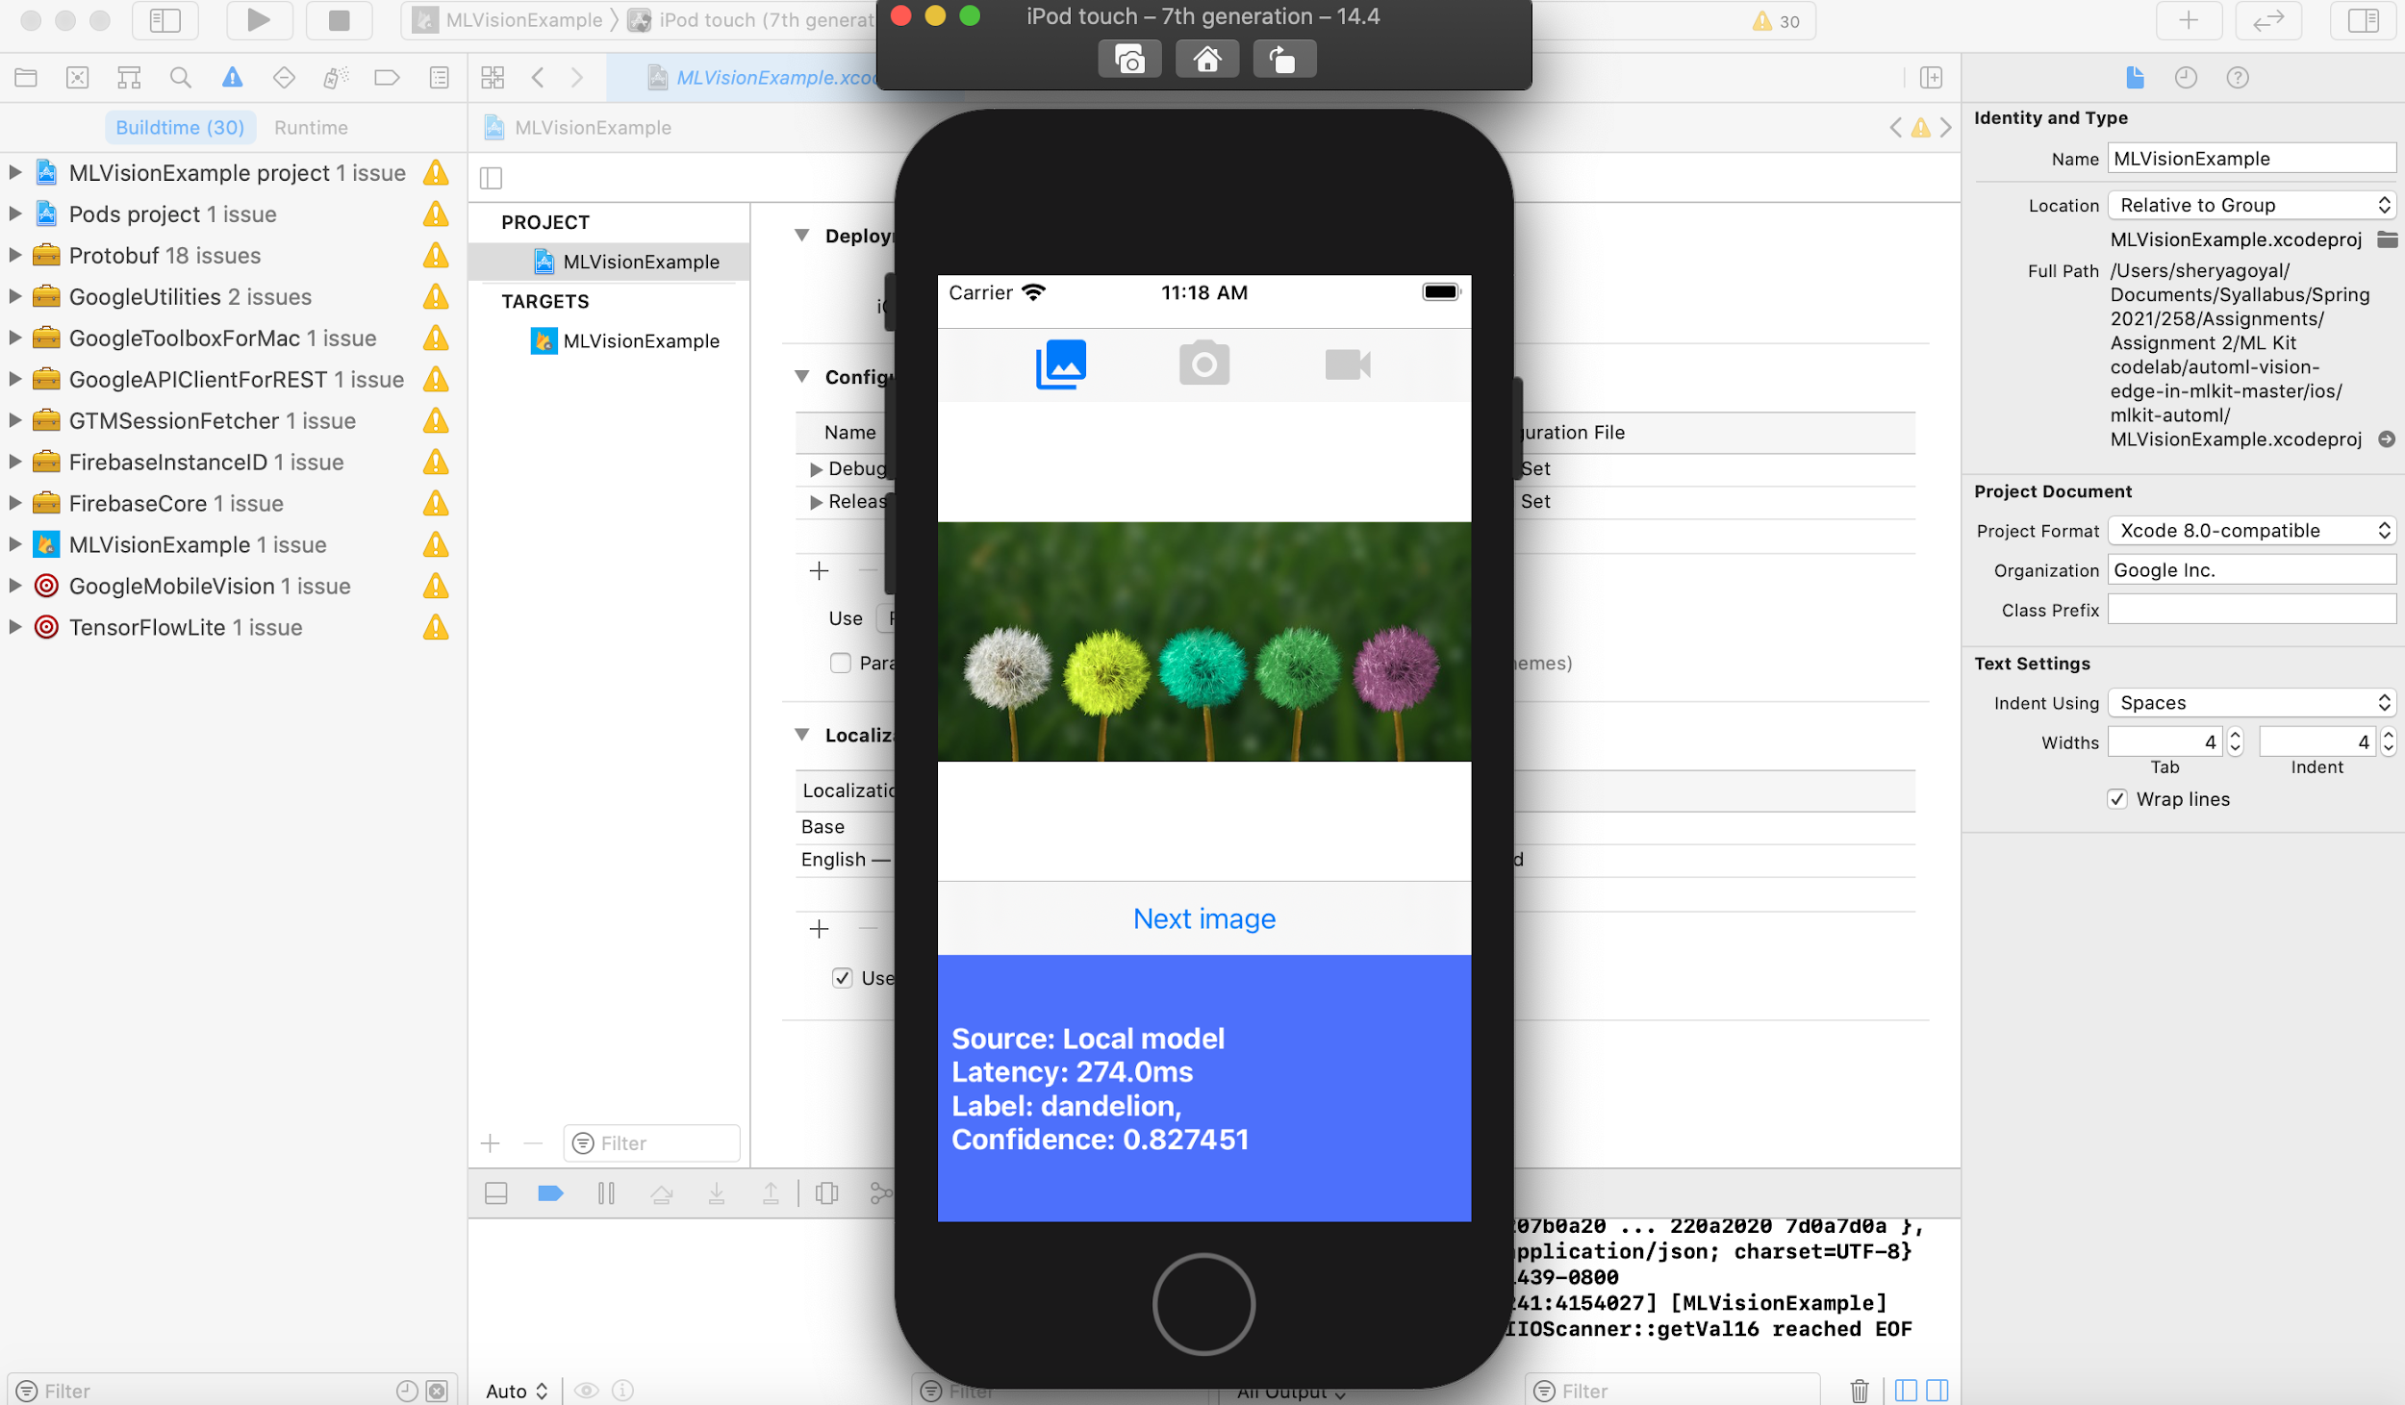
Deployment of Vision Model to Mobile Device
Prediction results: Ran the model in the ios Simulator

Slide 38
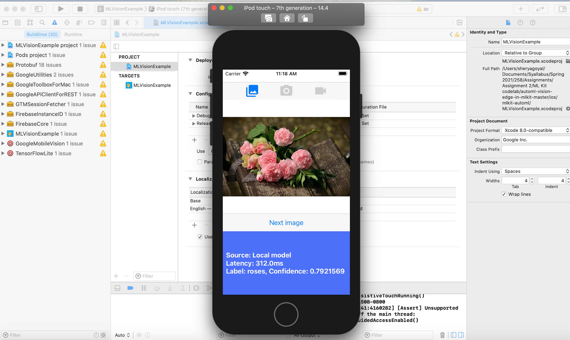
Deployment of Vision Model to Mobile Device
Prediction results: Ran the model in the ios Simulator

Slide 39
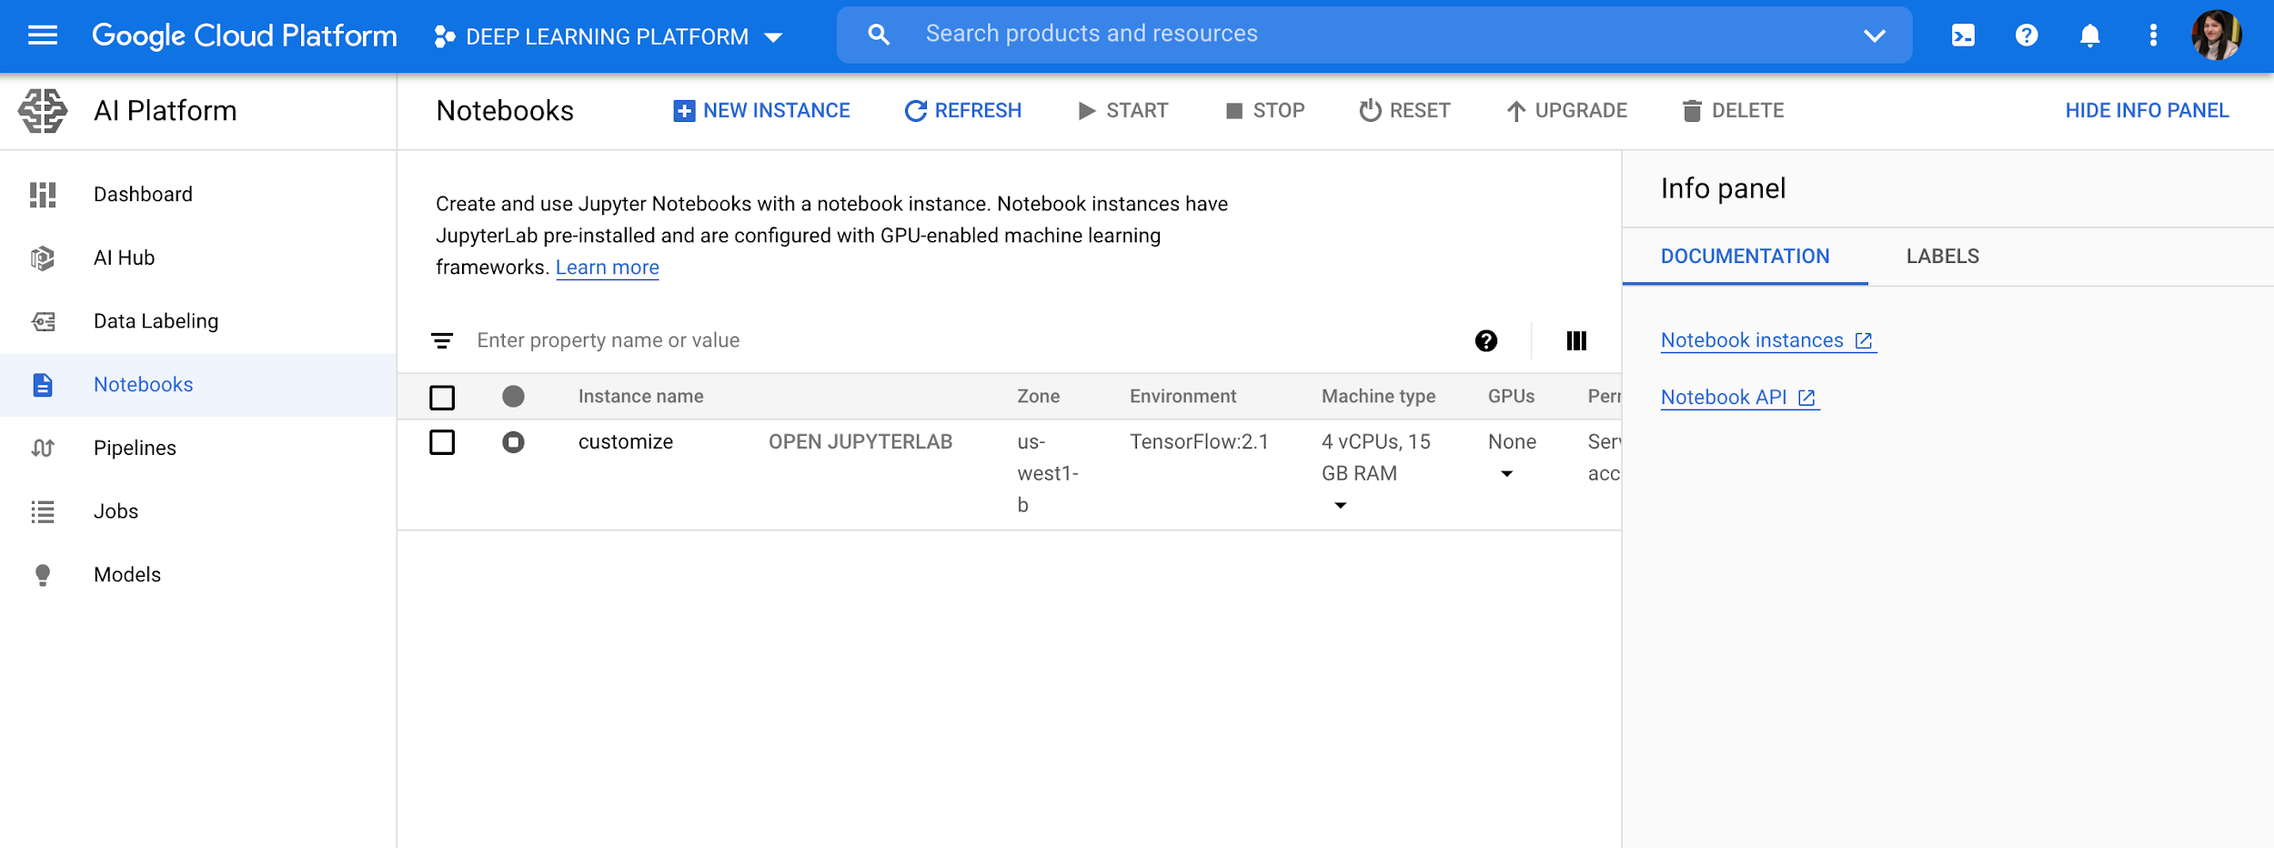
Timeseries Forecasting models
Created Notebook

Slide 40
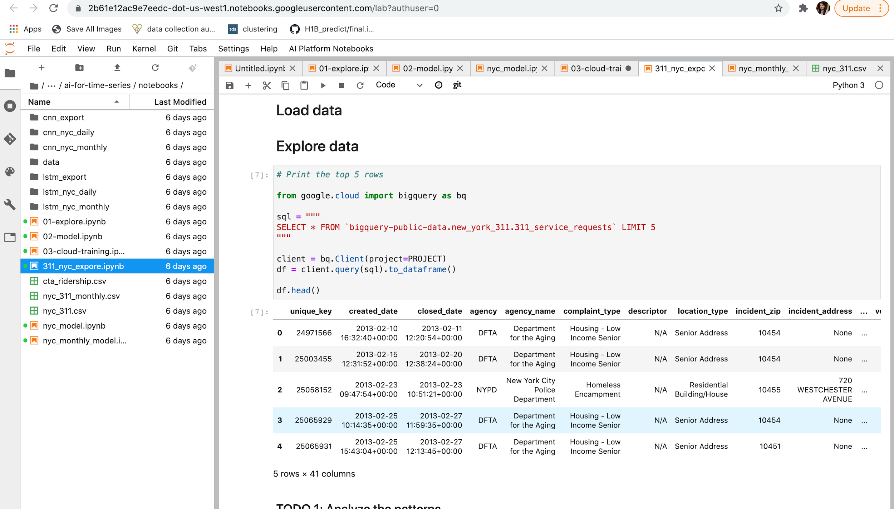
Timeseries Forecasting models
Ran this query for nyc 311 dataset

Slide 41
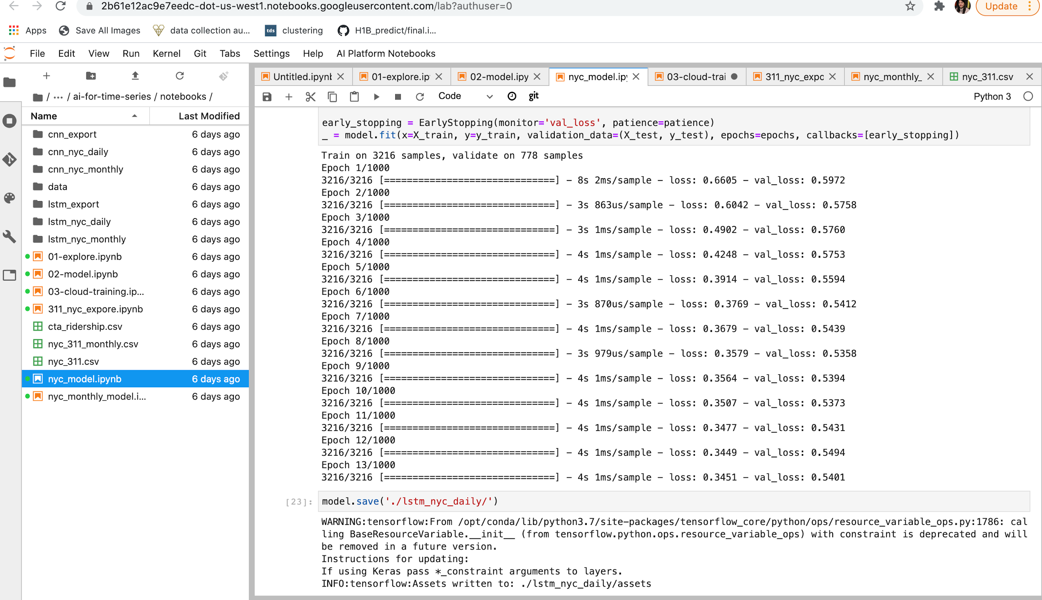
Timeseries Forecasting models
Saved nyc daily model

Slide 42
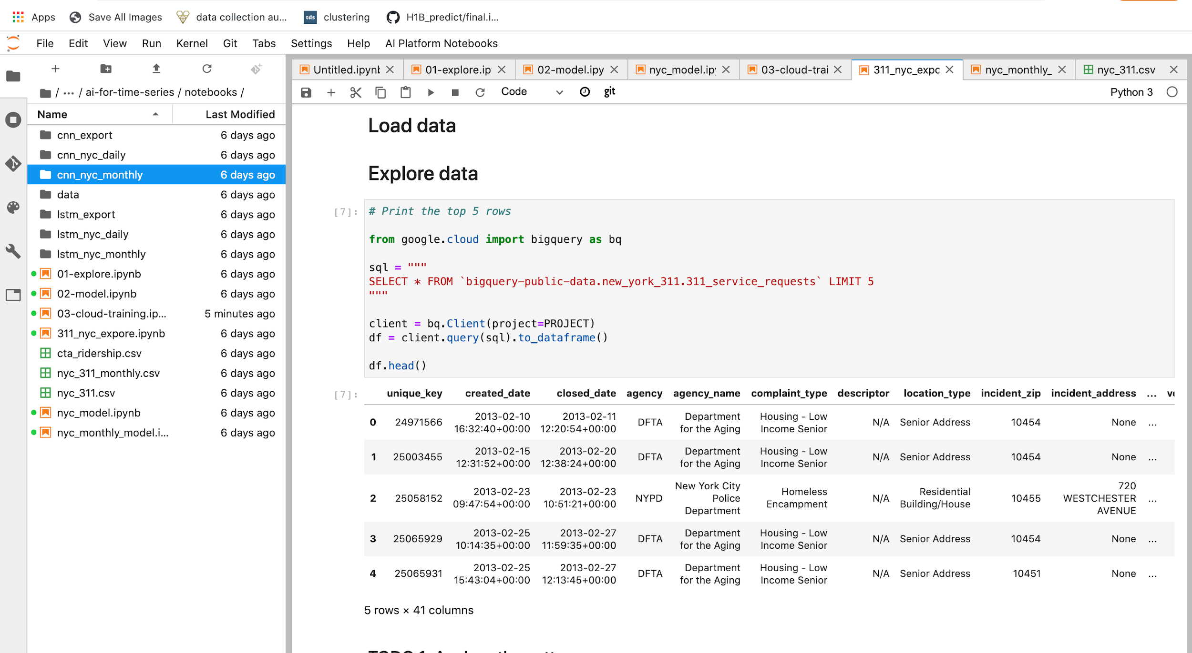
Timeseries Forecasting models
In the right, can check all the files created lstma and cnn model for nyc daily and monthly.

